Slide 1
Module 2:
Meetings and Committees

Slide 2
Module Objectives
Identify the soft skills associated with meetings and committees
Identify types of meetings and committees
Describe how to create meeting documents
Describe how effective meeting involve all parties
Describe the significance behind social activities

Slide 3
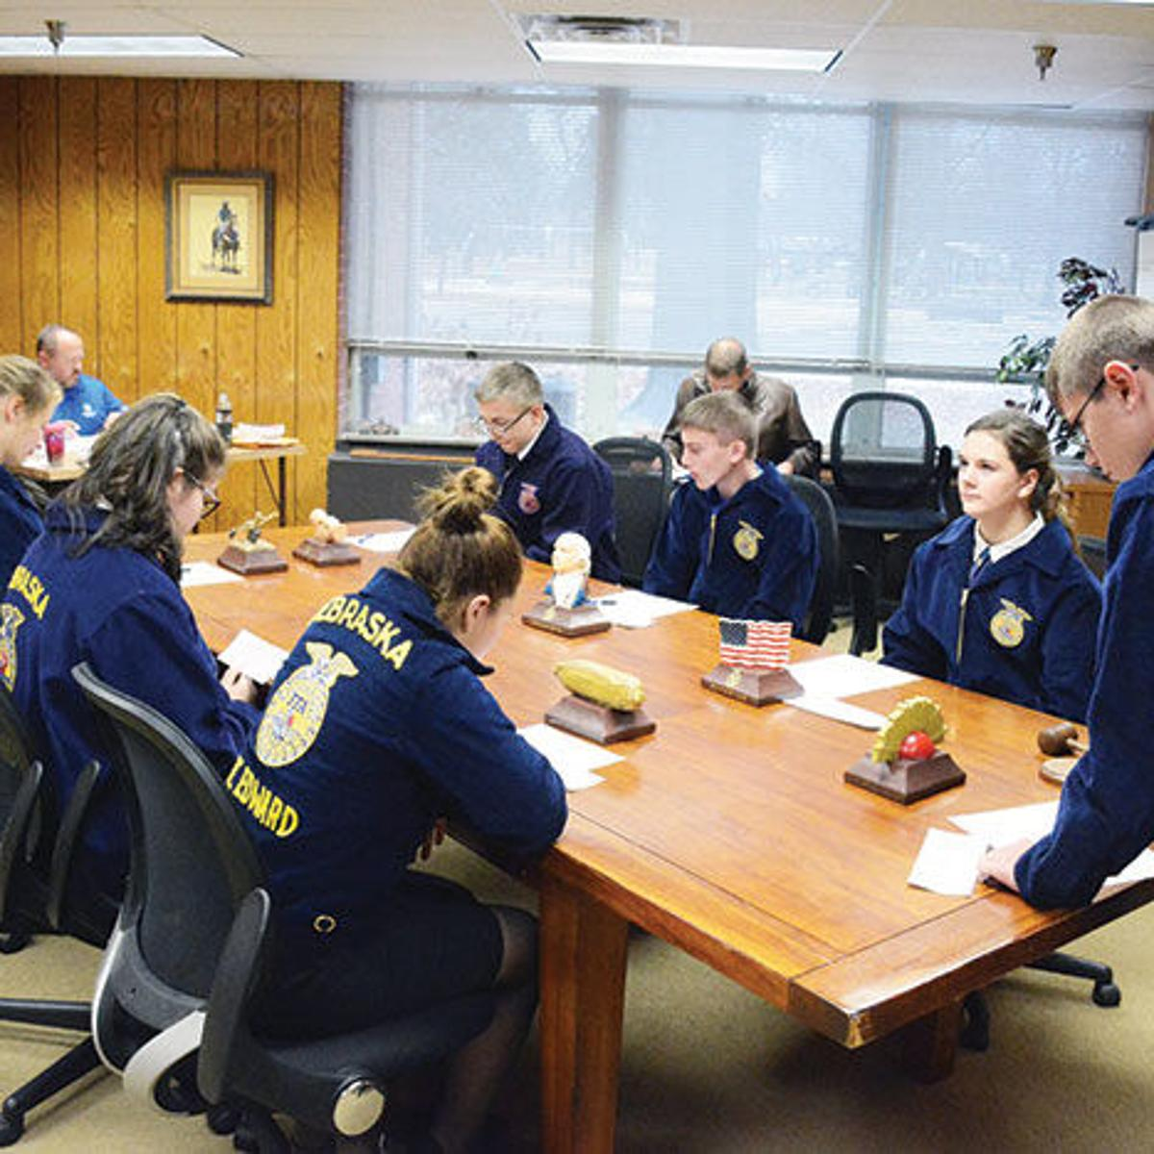
Philosophy
Participating in meetings and committees are valuable in learning how to work and communicate effectively in teams and manage time wisely. Students will grow into responsible citizens and gain social competence.

Slide 4
Standards
Time Management (clock icon)
Social Competence (group of people icon?)
CRP.01 Act as a responsible and contributing citizen and employee (briefcase icon)
CRP.04 Communicate clearly, effectively, and with reason.
CRP.12 Work productively in teams while integrating cultural and global competence.
Notes:
Morgan icons needed

Slide 5
Types of Meetings
Chapter Meetings
Officer Team Meetings
SAE Project Meetings
Committee Meetings
CDE/LDE Information Meetings
Advisory Committee Meetings
Parent/Student Meetings
School Board Meetings
Fundraising Meetings
Farm Bureau Meeting

Slide 6
Types of Committees
Function all year long.
Conducts annual activities.
Standing Committees
Consists of the chapter officers and standing committee chairpersons.
Lasts one year and changes when new officers are elected.
Executive Committees
Function for non-annual special events.
Lasts until the specific event assigned is completed.
Special Committees

Slide 7
Example Committee Responsibilities
Standing
Committee
Greenhand Initiation
Annual Fundraisers
Executive
Committee
Chapter Meetings
Award Ceremonies
Special
Committee
Community Service Projects
Float Building

Slide 8
Vital Meeting Documents & Resources
Agenda
Officer/Cmte
Reports
Minutes
Visual-Aids
Attendance Sheets
Parliamentary Basics

Slide 9
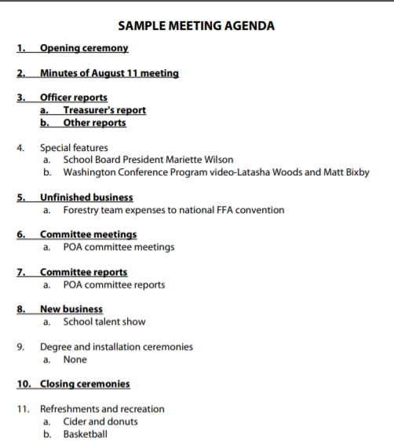
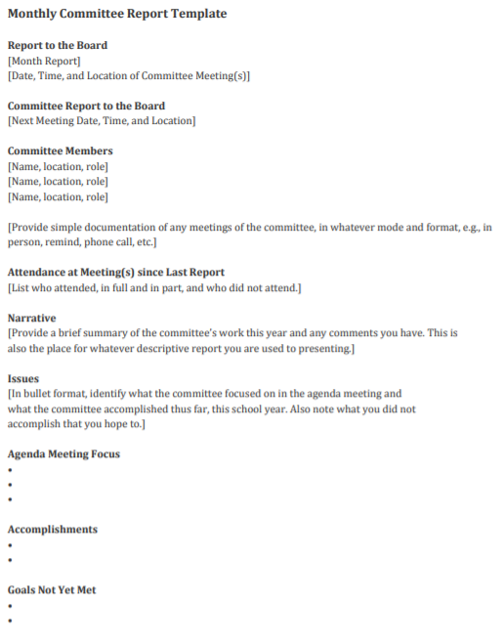
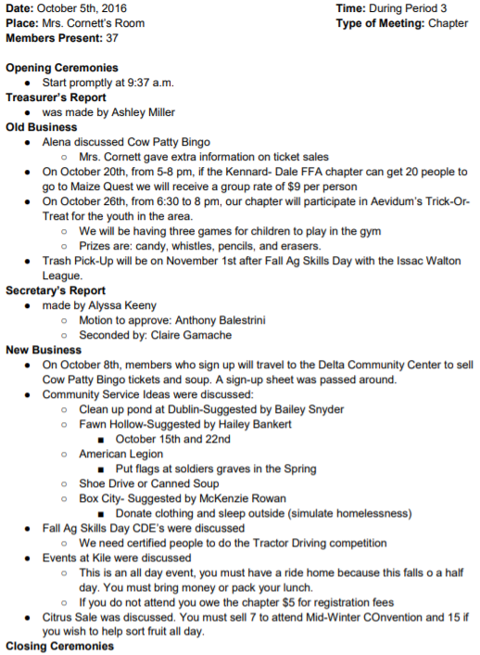
Agenda
Reports
Minutes
Makes sure that a meeting stays on track.
Records committee progress.
Records meeting decisions, measure progress, and act as an accountability tool.
Serving at a soup kitchen
Community/Campus Beautification
Serving at Community Centers/Shelters
Notes:
Provide morgan with screen shot
She will do a scroll over the document with video effects
She will also add the blurb

Slide 10
Agenda
Reports
Mi
MAKES SURE THAT A MEETING STAYS ON TRACK.
RECORDS COMMITTEE PROGRESS.
RECORDS MEETING DECISIONS, MEASURE PROGRESS, AND ACT AS AN ACCOUNTABILITY TOOL.
Notes:
Provide morgan with screen shot
She will do a scroll over the document with video effects
She will also add the blurb

Slide 11
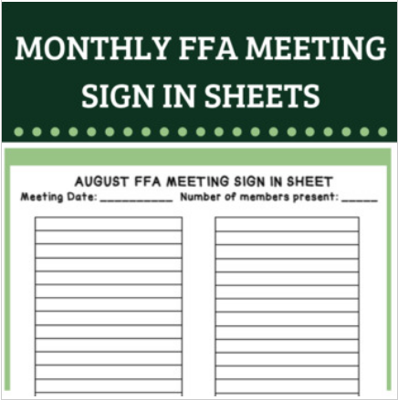
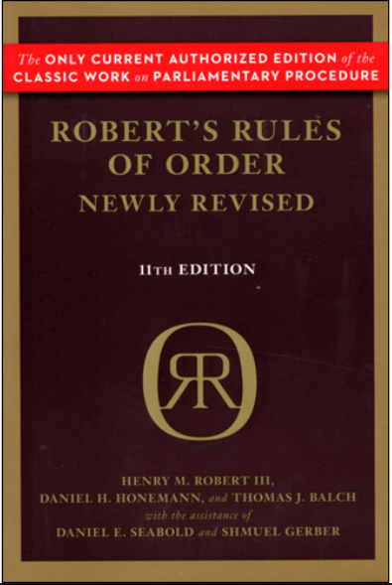
Visual Aids
Attendance Sheets
Parliamentary
Basics
Effectively engage chapter members and meeting attendees.
Records member attendance.
Can be electronically done - AET
Ensures orderly meetings.
Notes:
Same idea as previous slide
Mention attendance can be connected to AET with scanned codes
Cheat sheet with parli pro

Slide 12
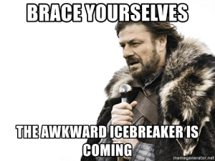
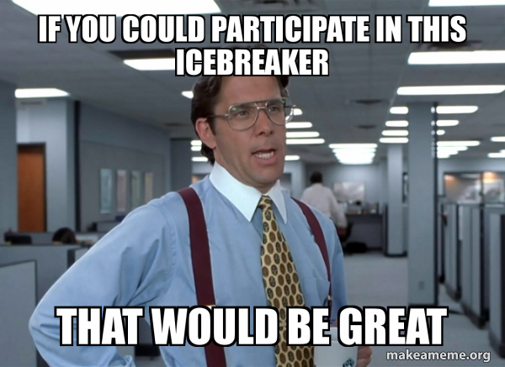
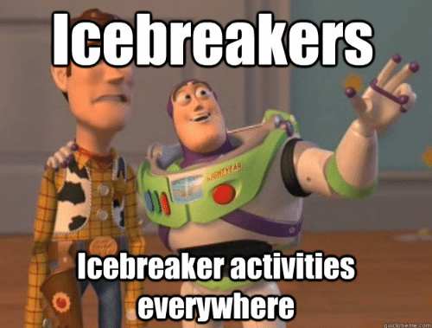
Integrating Social Activities
Two Types of Activities:
Icebreakers - Designed to warm up and increase comfortability of attendees so that they contribute to the meeting or activity.
Start meeting with an activity = Set tone for rest of the meeting
Mixer - Intended to give participants opportunities to meet new people

Slide 13
Benefits of Social Activities
Set a tone of fun
Allow the participants to “get out of their comfort zone”
Get participants up and moving
Build a sense of team – group bonding
Mix up audience (separate friends)

Slide 14
An Effective Meeting
Meeting Leaders Who Are...
Attendees Who Are...
Effective Meeting
People brought together for a purpose
Provides a forum for open discussion
Delivers a tangible result
Engaging
Organized
Professional
Interactive
Punctual
Responsive
Time Management
Social Competence

Slide 15
Chapter Spotlight:
O’Neals Minarets FFA
Notes:
We’ll get to see how a local chapter, O’Neals Minarets, executes effective chapter and committee meetings through the means of parliamentary procedure and other methods.

