Slide 1
Module 6:
Public Speaking

Slide 2
Module Objectives
Identify the soft skills associated with public speaking
Identify the benefits of public speaking
Describe strategies to overcome nervousness
Describe areas to engage students in public speaking.

Slide 3
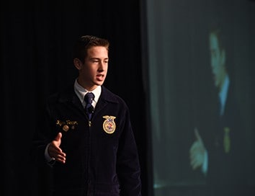
Philosophy
Participating in public speaking develops students emotional control, teaches students to communicate more effectively, and demonstrates knowledge of technical skills.

Slide 4
Standards
Career Ready Practices
Emotional Control
CRP.02 Apply appropriate technical skills.
CRP.04 Communicate clearly, effectively, and with reason.
Maintains control when student is faced with potentially stressful situation.

Slide 5
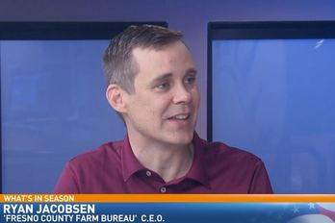
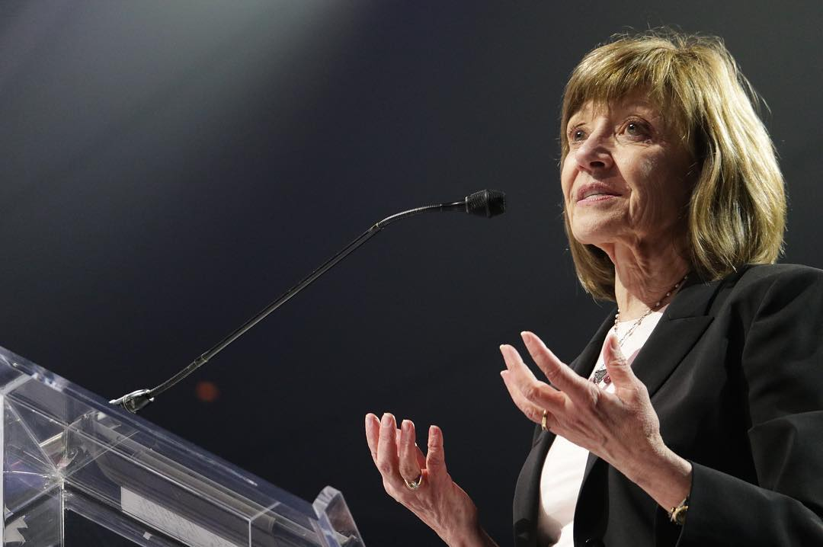
Benefits of Public Speaking
Personal
Professional
Public

Slide 6
Overcoming Nervousness
Students feel more anxious communicating...
In unfamiliar situations
With strangers
In front of large audiences
In situations that involve evaluation
When others have high expectations
Ways to combat nervousness:
Select a comfortable topic
Be prepared
Practice how you play
Positive attitude

Slide 7
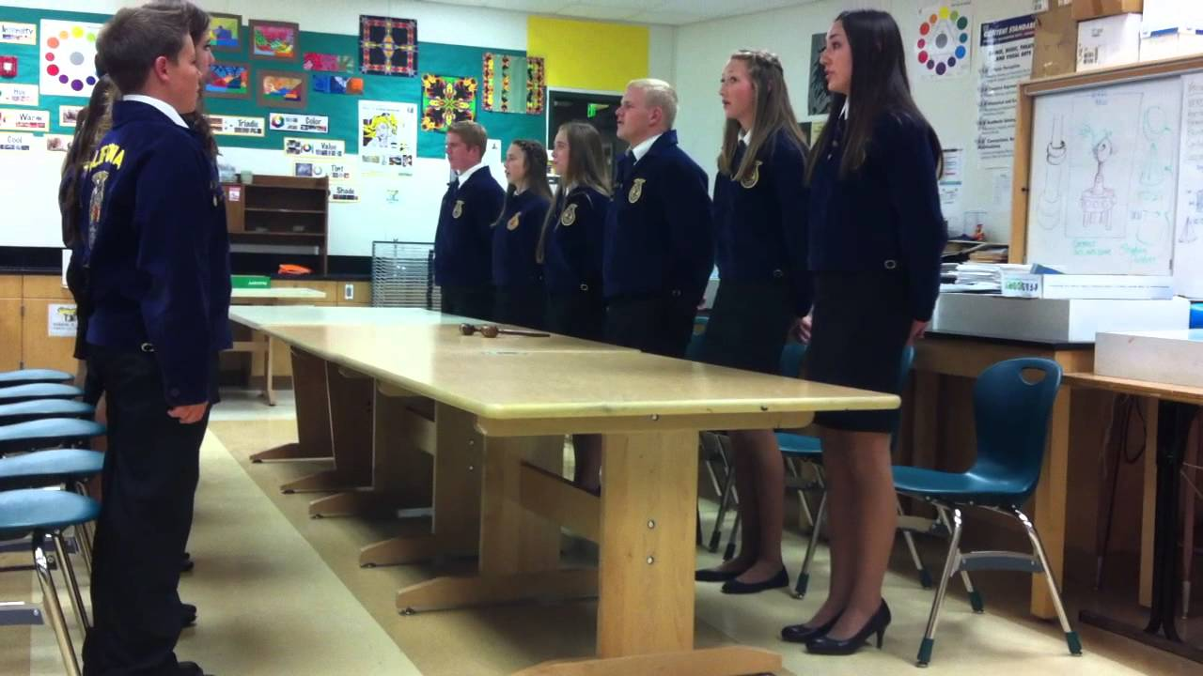
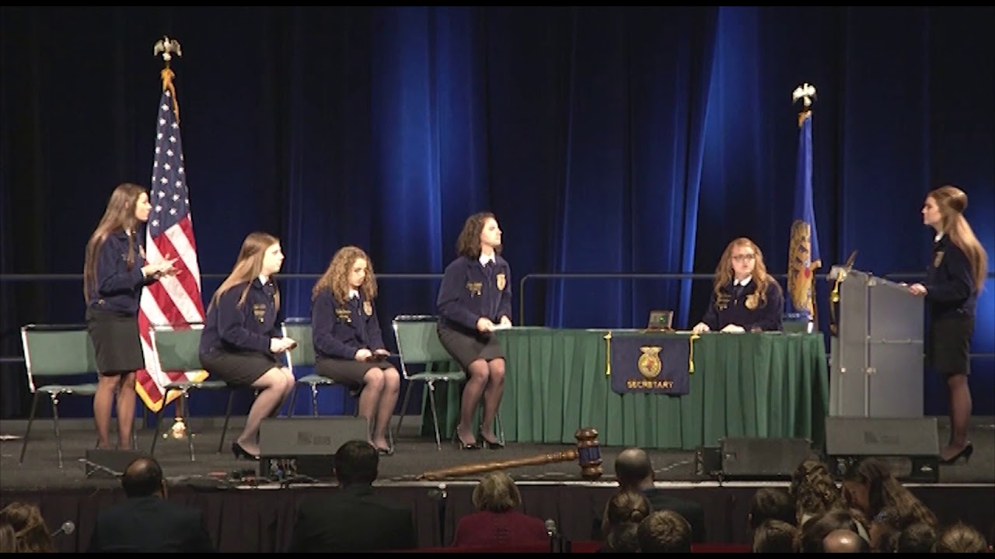
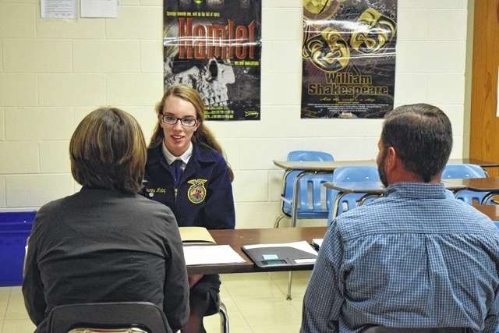
Speaking Contest

Slide 8
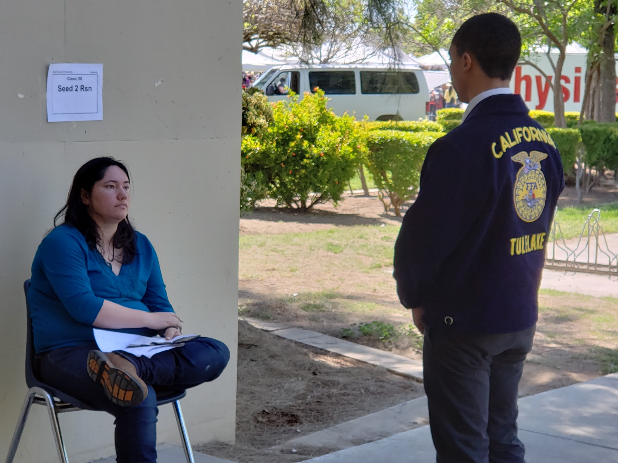
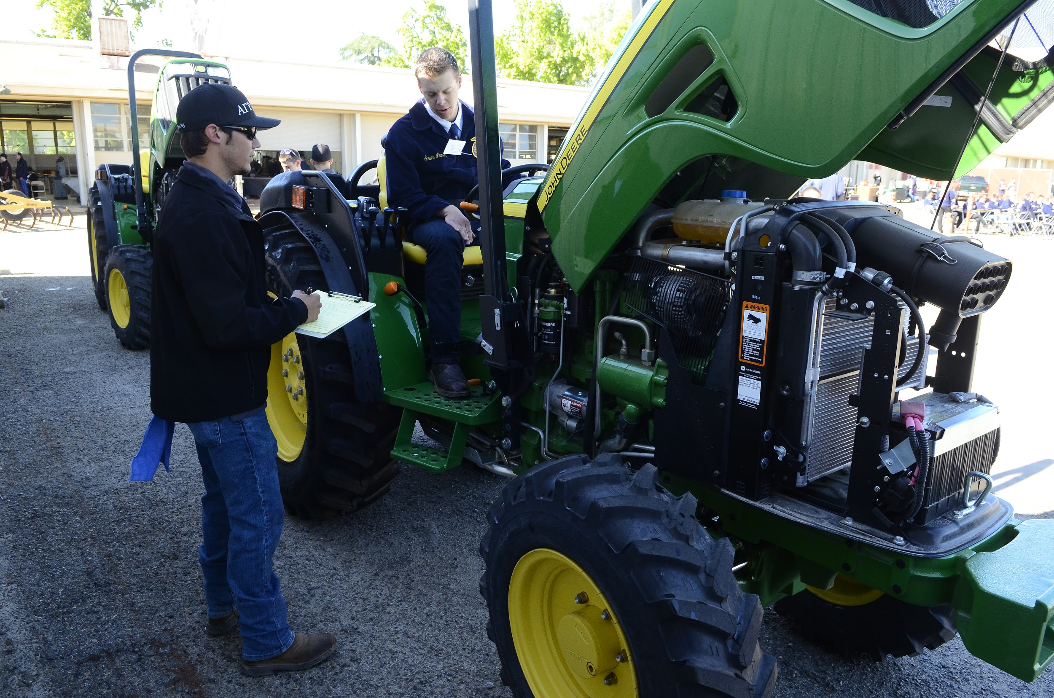
Speaking within a Contest

Slide 9
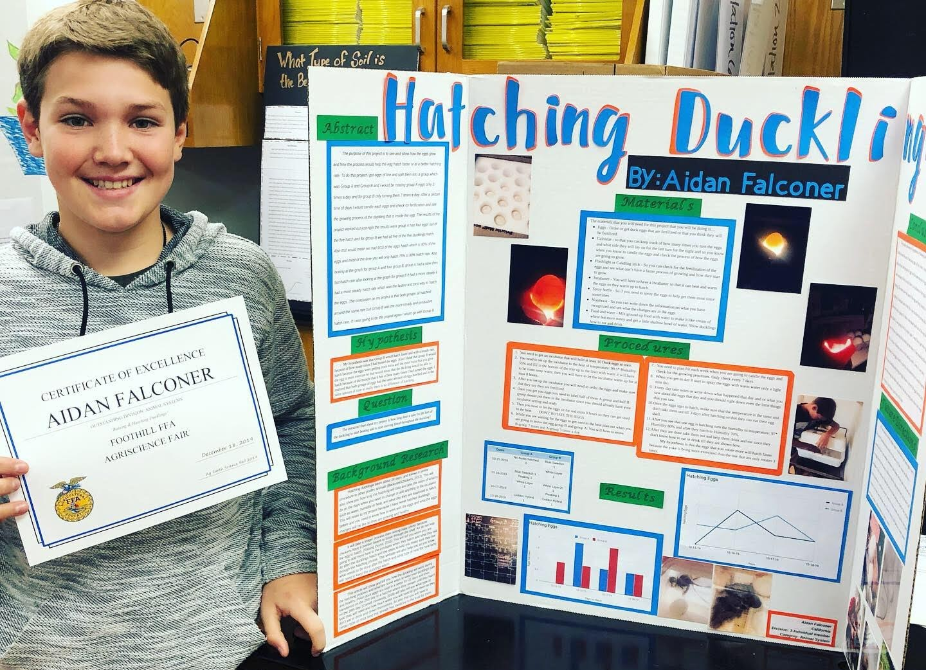
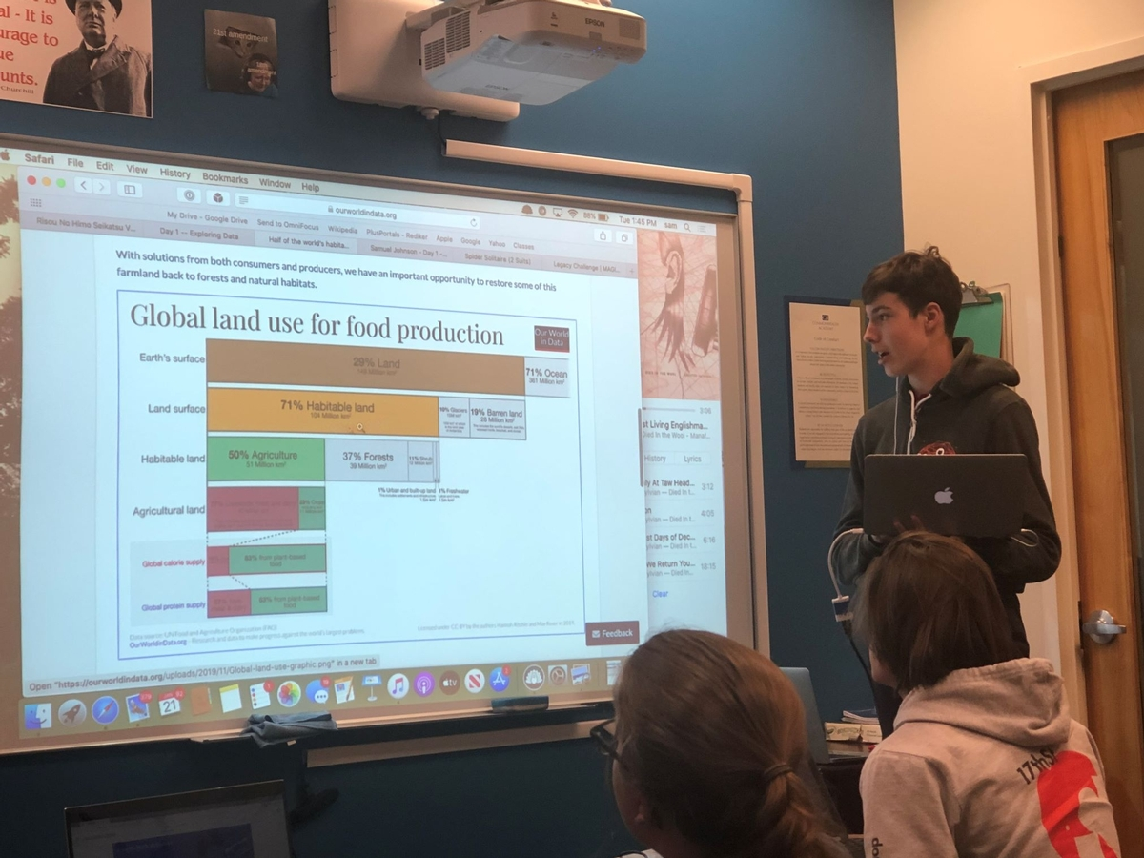
In-Class Presentation

Slide 10
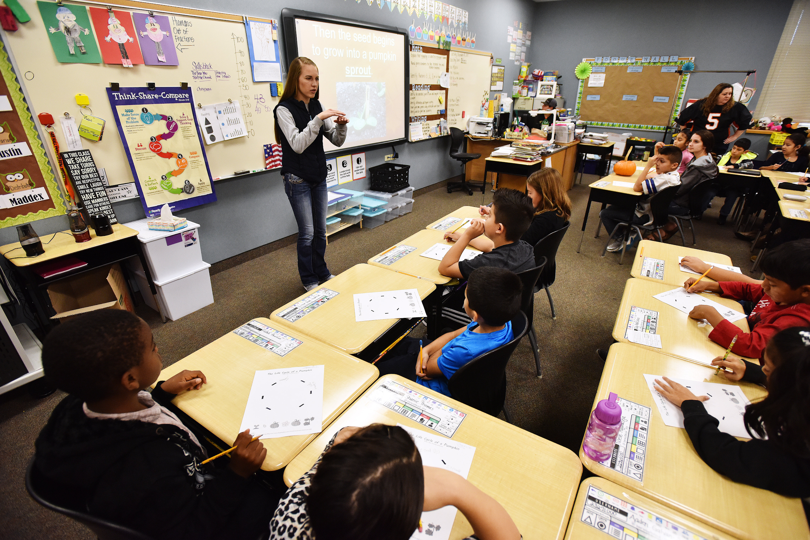
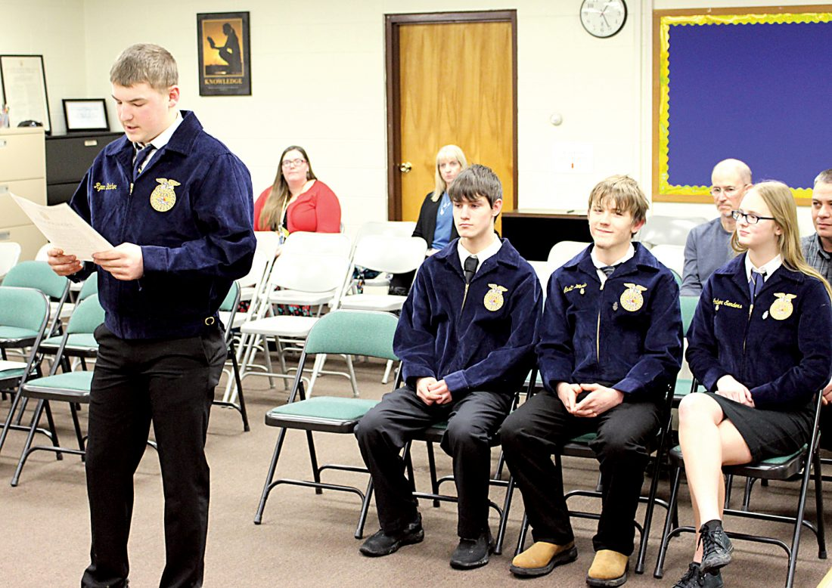
Formal Presentation

Slide 11
Chapter Spotlight:
Sierra FFA

