Slide 1
Spotlight On
ACRS 21

Slide 2
Overview of Program
Creation of the ACRS21 Certificate Program
Ag Industry has expressed need for more highly qualified employees
AAAE - National Research Agenda Priority
Transferable Certificate Pathway
HS to CC to University
Experiential Learning Aligned to Soft Skills and Career Readiness Practices

Slide 3
ACRS21 Student Team

Slide 4
Career Counseling Center

Slide 5
AET Team

Slide 6
Logo, slogan, mission statement
Slogan: “Cultivate Your Pathway”
Mission Statement: ACRS21 is a certificate pathway that brings together industry professionals, agriculture educators, and the community to boldly prepare successful students to become future industry leaders through real-world experiences, soft skills development, and career readiness for the 21st century.

Slide 7
Highlight Major Components
High School Certificate Requirements
Community College Certificate Requirements
Soft Skills and Career Readiness Standards
Progression of Certificate Pathway
Agricultural Experience Tracker (AET)
Teacher Training Modules
Career Counseling Guidelines

Slide 8
Certification Requirements for High School
Includes nine different sections
Each section aligns with Soft Skills and CTE Standards
Students will record in AET
Checklist items have specifics on hour requirements, examples and what is being assessed on the Certification Requirement Checklist

Slide 9
Example Activities
Leadership Activities/Positions
FFA Conferences, Facilitate/Attend Workshops, FFA Officer/Committee Positions
Team Participation
CDE/LDE Teams, classroom projects, group work settings
Formal Public Speaking
Board meetings, competitive speaking events (creed, impromptu, etc.)

Slide 10
Advisor Checklist & Student Interview
Final Approval
Teacher will meet with students
Complete certification checklist to verify AET entries
Discuss continued educational plans
Review career goal plans

Slide 11
Certification Requirements for Community College
Includes nine different sections
Certification to be done in two-years (hours are transferable)
Each section is tailored to aspects that are community college appropriate

Slide 12
Example Activities
Job Shadowing and Internships
Formal work experience and signed off by employer
Agri-Science
Research can include class research projects/activities
Career Counseling Sessions
Meeting with counselors to discuss work, higher education, and other goals

Slide 13
State AG Ambassador Conference
Fresno State in conjunction with other ag universities
Virtual Conference held in the spring
Industry professionals, speakers, university alumni

Slide 14
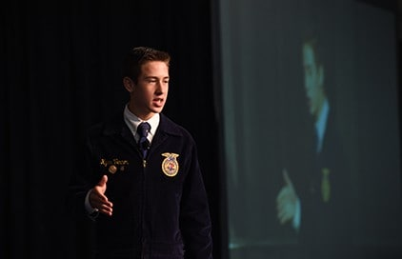
Soft Skills & Career Readiness Standards
They Align!!!
Experiential Learning
Soft Skill Development
CTE Standards

Slide 15
Example of Alignment
Experiential Learning | Soft Skill | CTE Standards
Community Service | Achievement Motivation Active Initiative | CRP.01 Act as a responsible and contributing citizen and employee. CRP.06 Demonstrate creativity and innovation.
Public Speaking | Emotional Control | CRP.02 Apply appropriate technical skills. CRP.04 Communicate clearly, effectively, and with reason.

Slide 16
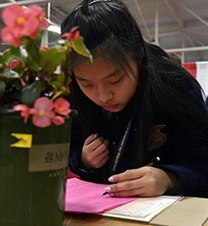
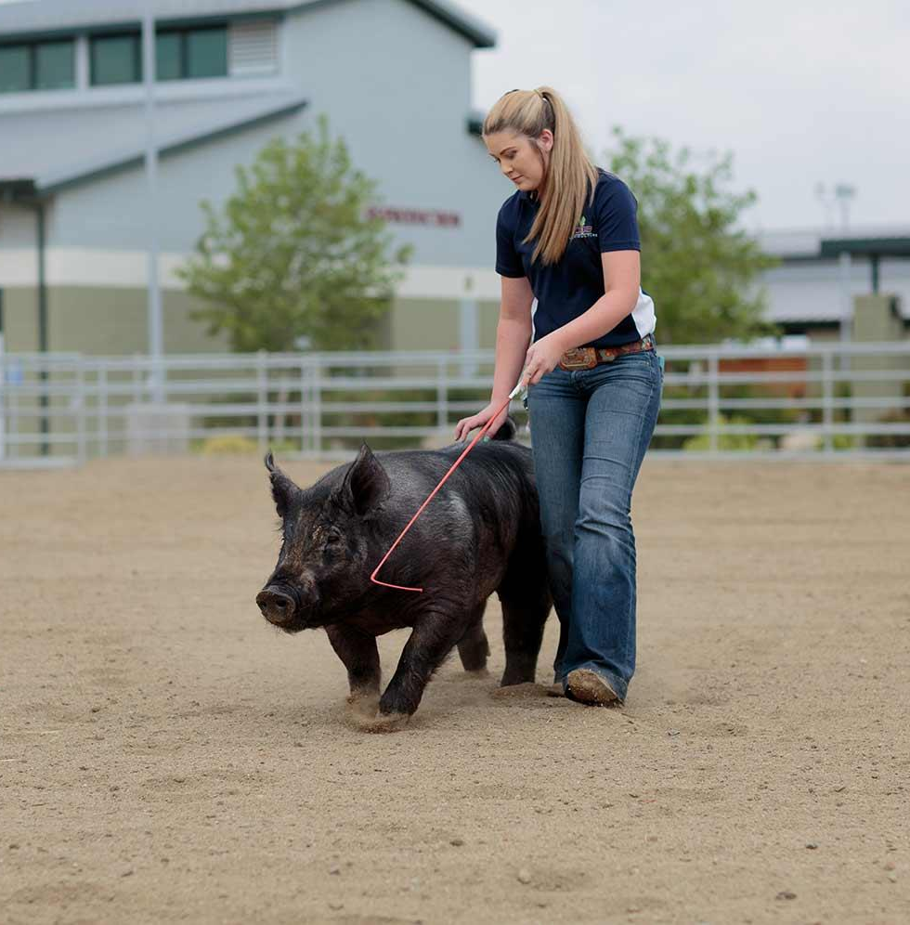
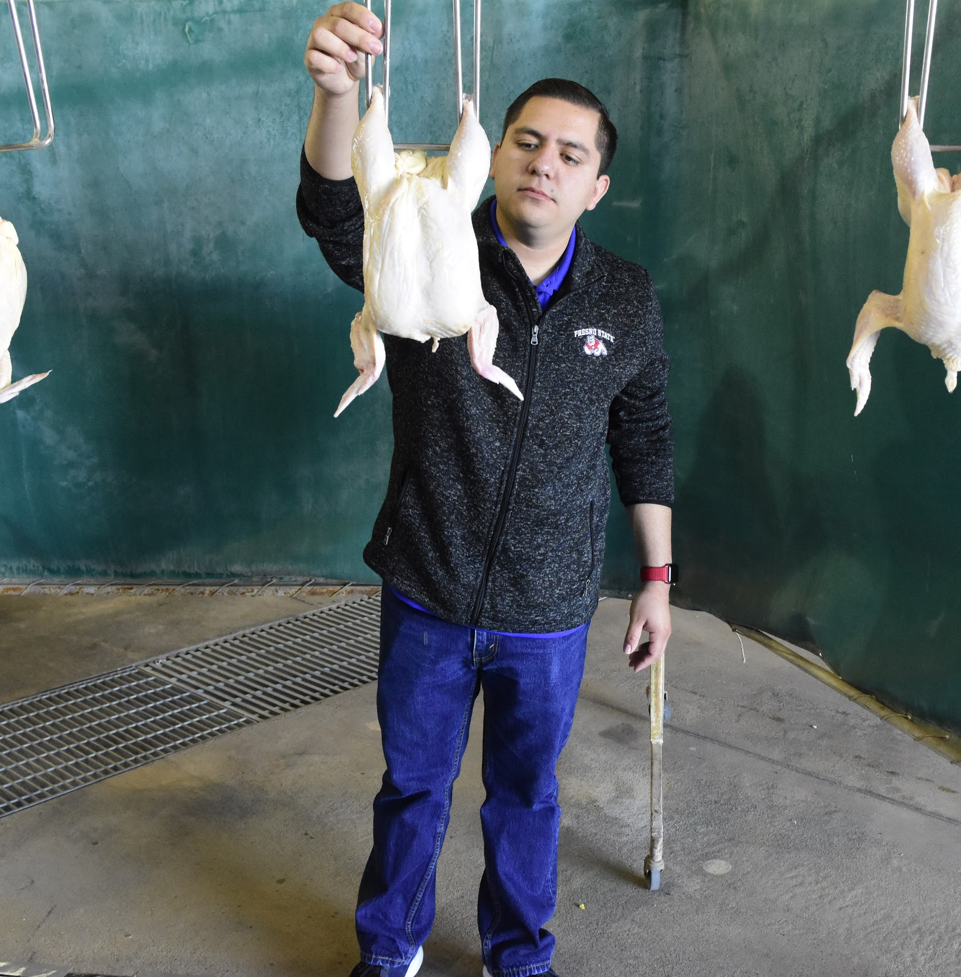
Progression of Certificate Pathway
High School
Community College
University

Slide 17
Progression of Certificate Pathway
Experiential Learning | High School | Community College | University
Leadership Activities/Positions | 40 | 70 | 100
Job Shadow/Internship | 12 | 20 | 30

Slide 18
AET
High School
Community College
University (Fresno State)
Students will record their activities on AET at three different levels
The Certificate Requirements will be automatically checked off as students complete activities
Soft Skills Assessments for Data Analysis
A Resource Folder will be used to house teacher training modules, counselor resources, and ACRS21 Certificate Pathway forms

Slide 19
Teacher Training Modules
10 Videos for teachers
Introduce teachers to ACRS21 certificate pathway
Designed to “Teach the Teacher”
Provides examples, explain processes, and supply teachers with resources

Slide 20
Teacher Training Modules
Modules Include:
An introduction to the pathway
Meeting Participation
Leadership activities/ positions
Team Participation
Community Service
Public Speaking
SAE Projects/ Work Experience
Job Shadow/ Internship
Career Counseling

Slide 21
Career Guidance Resources

Slide 22
Thank You

