Slide 1
Module 9:
Agriscience

Slide 2
Module Objectives
Describe the scientific method.
Explore the categories of agriscience research.
Discover the agriscience fair and it purpose.
Explore how research SAE’s are created and developed.
Understand the soft skills associated with agriscience.

Slide 3
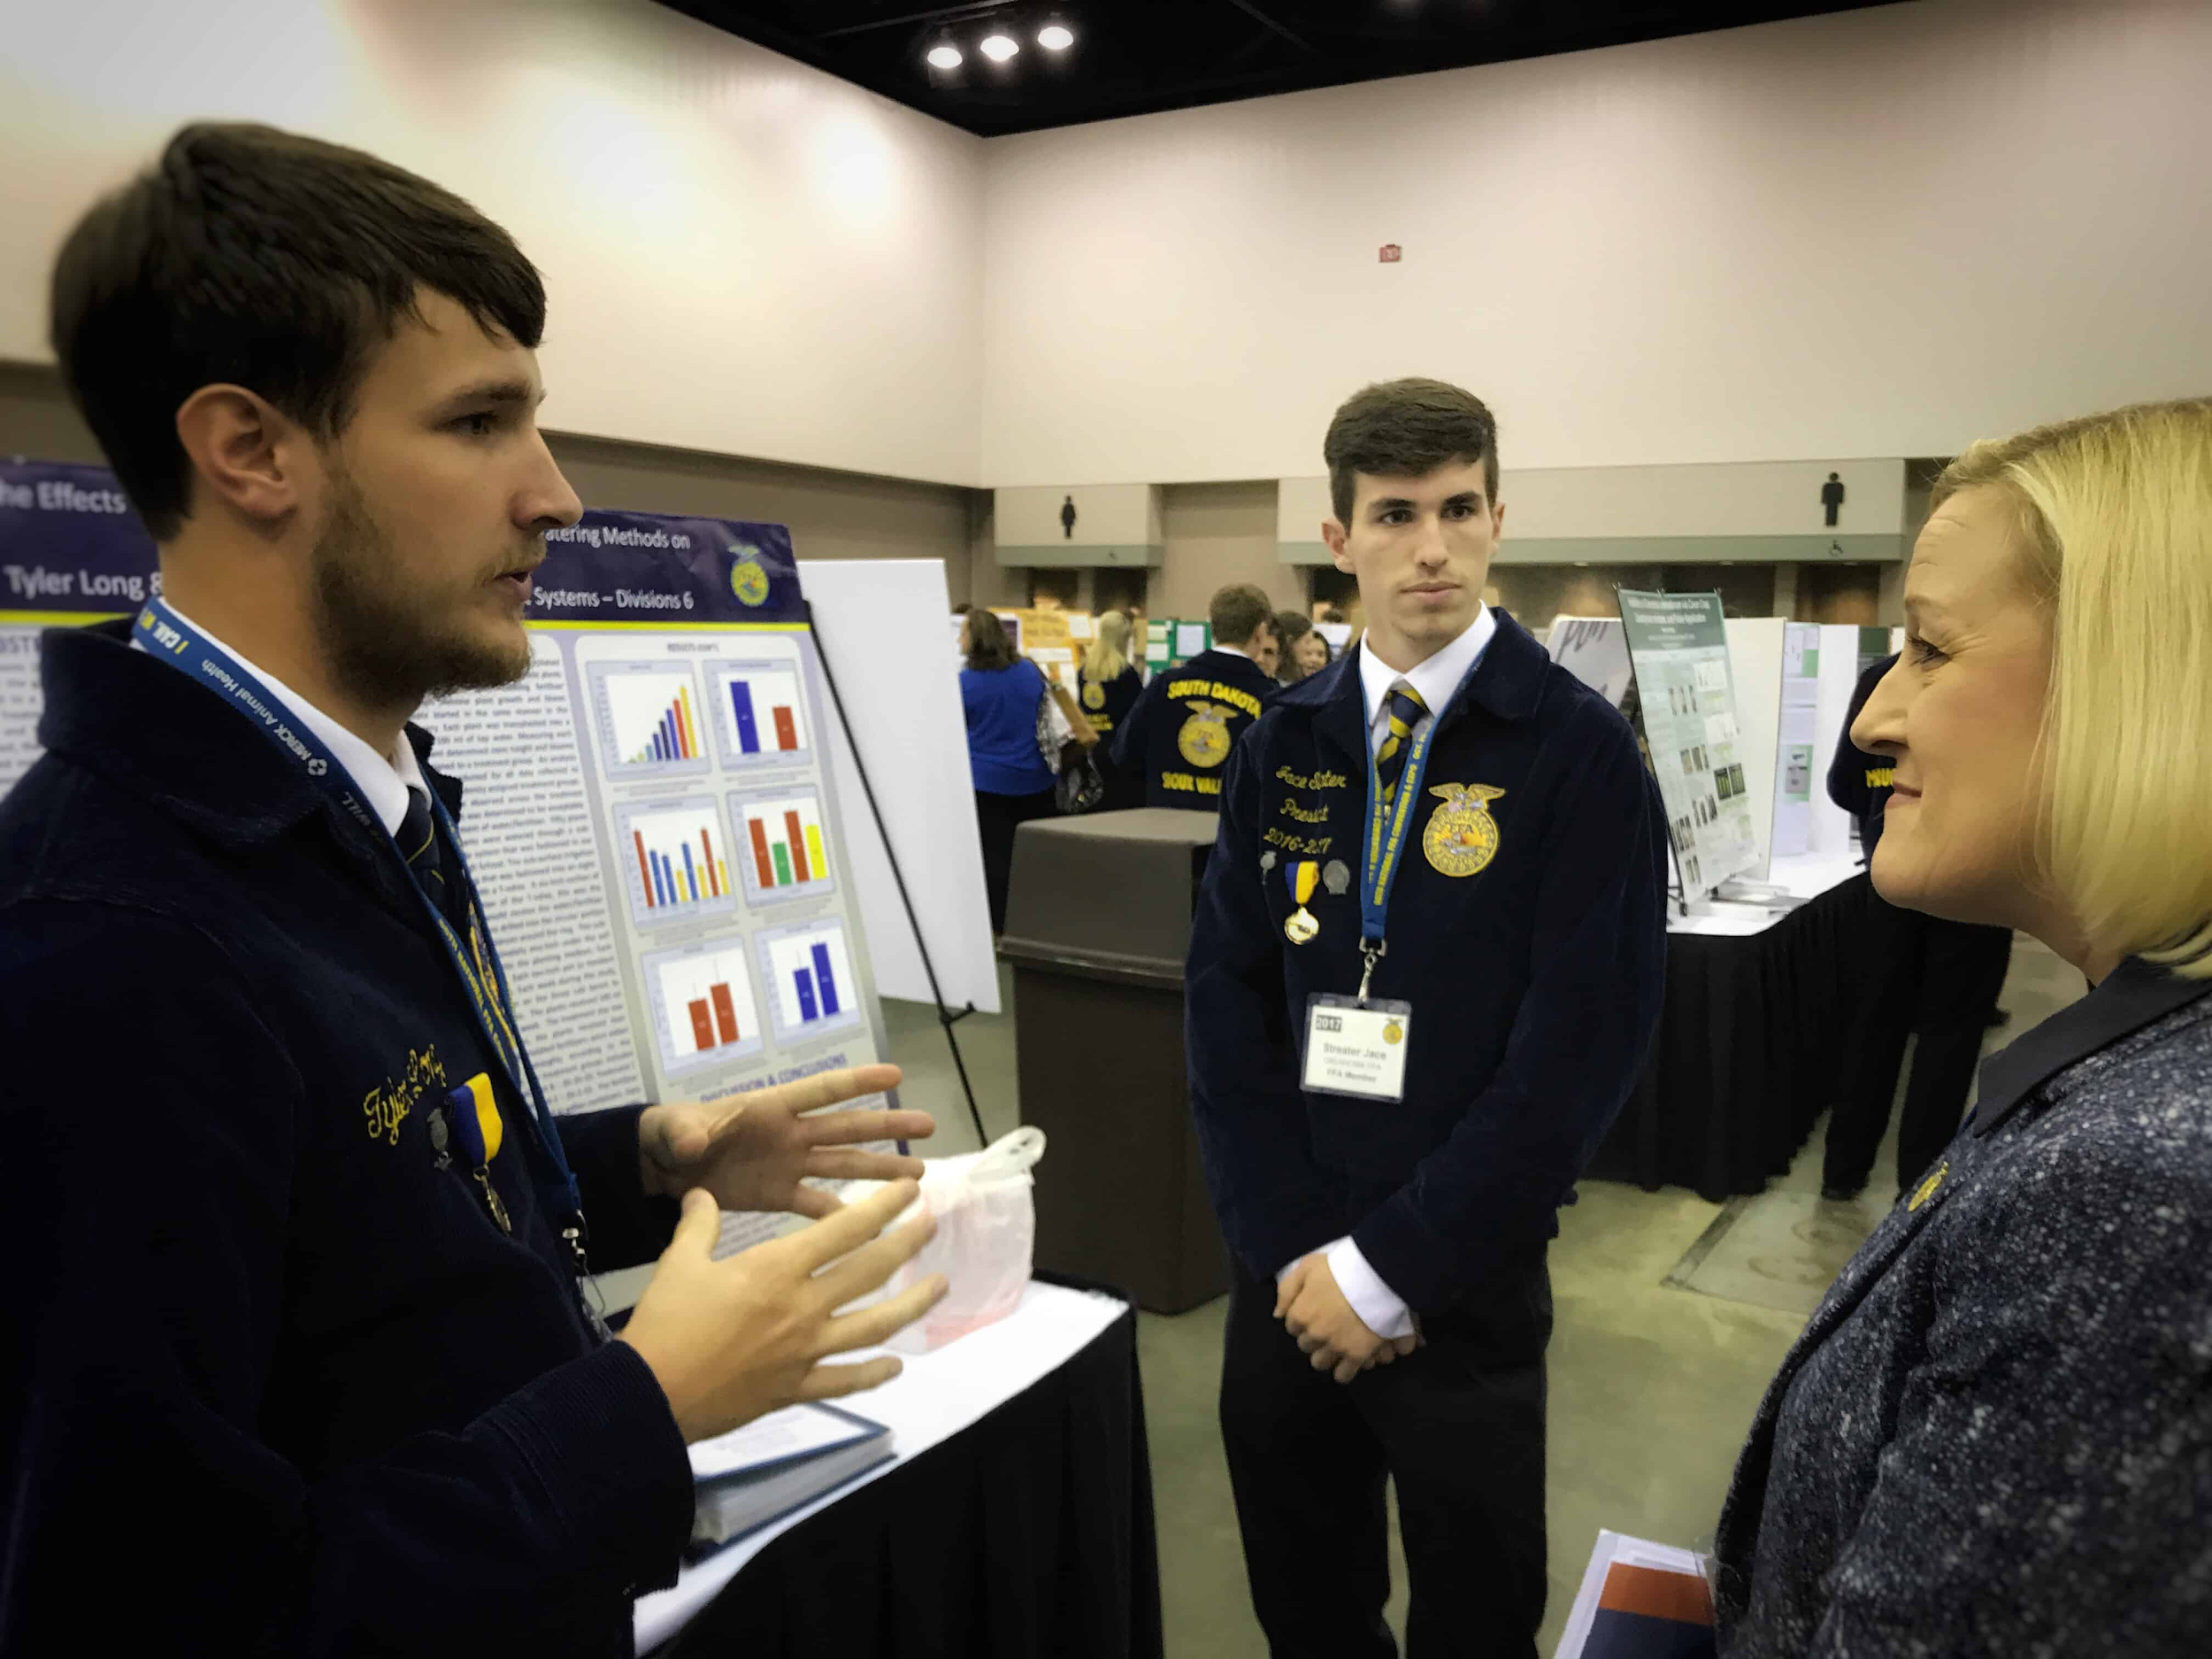
Philosophy
Conducting reliable scientific research allows students to discover technical skills, enhance their critical thinking, and create innovative solutions to today’s scientific problems.

Slide 4
Standards
Intellectual Flexibility
Career Readiness Practices
Can adapt one’s thinking and accommodate new information from changing conditions and different perspectives.
CRP.02 Apply appropriate technical skills.
CRP.06 Demonstrate creativity and innovation.
CRP.07 Employ valid and reliable research strategies.
CRP.08 Utilize critical thinking to make sense of problems and persevere in solving them.

Slide 5
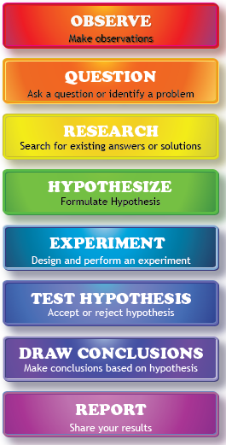
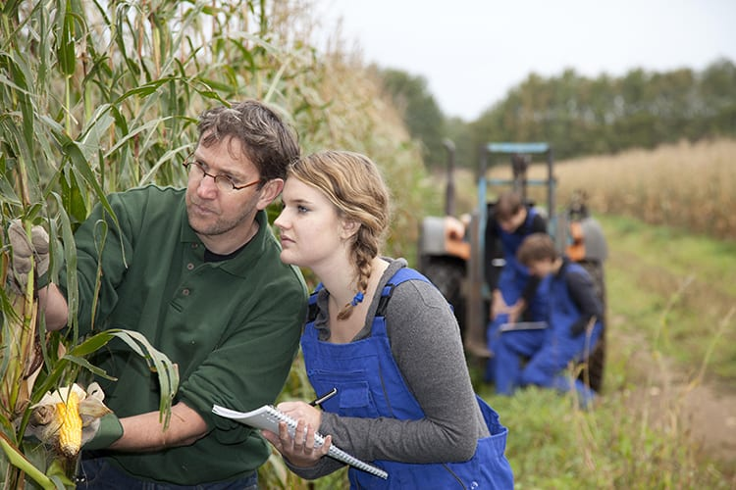
Scientific Method
Intellectual Flexibility
CRP.02 - Technical Skills
CRP.07 - Research Strategies
CRP.08 - Critical Thinking

Slide 6
Agriscience Research
Animal Systems
Environmental Services/NR Systems
Plants Systems
Power, Structural, and Technical Systems
Food Products and Processing Systems
Social Science

Slide 7
National FFA Agriscience Fair
Scientific Principles + Emerging Technologies = Solve Complex Problems
Agriculture Issue
Research Objectives
Following Procedures
Collect & Analyze Data
Time Commitment
Teacher Supervision

Slide 8
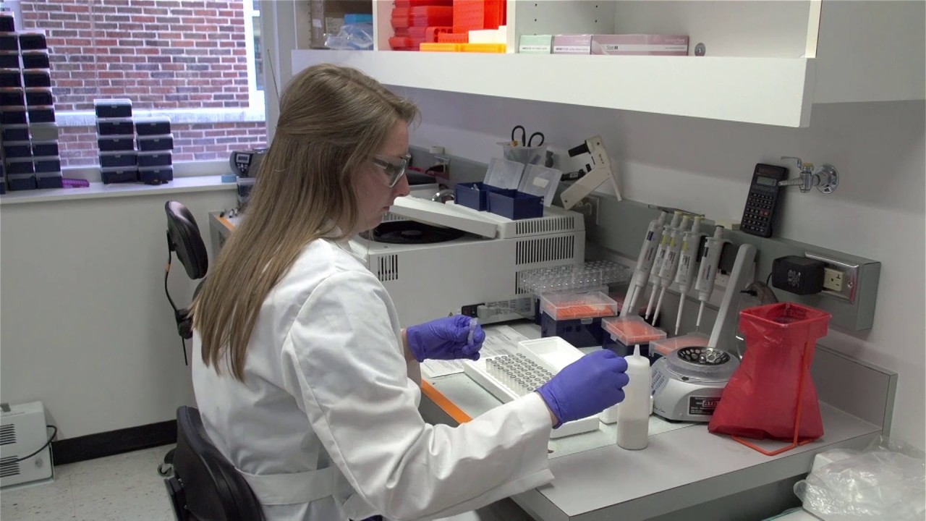
Agriscience SAE
(Research Immersion SAE)
Develop a research question
Work through scientific method
Acquire new knowledge
Create the final product
Documentation
Published Research
Data Report
Invented Product

Slide 9
Agriscience SAE
(Research Immersion SAE)
Application of scientific method.
Control/manipulate variables.
Hypothese
Conduct research
Collect data
Recommend further data
Experimental Research
Ask why or how something occurs.
Data collection
  Quantitative
  Qualitative
Invention Research
Analytical Research
Applies engineering design process.
Identifies need
Prototyping & Testing
Create a final product

Slide 10
Agriscience in the Classroom
Learning Plan Overview
01
Opportunity Identification
What to study
  E-mail USDA ARS researcher
  Teaching students to draft professional e-mails
02
Opportunity Identification
Identifying My Research
  Agriscience Interviews
  Interview student who’s completing an agriscience project
03
Career Plan Connection
Practice Makes Perfect
  Students share their elevator pitch
04
Outcome Brainstorming
Research SAE Mirror
  Students develop perspectives on research project
    Research vs Viewer
Bonus Activities
Discover resources within the Next Generation Science and Engineering Standards

Slide 11

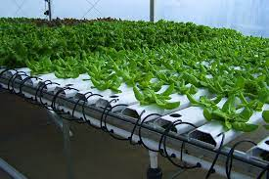
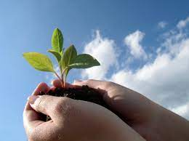
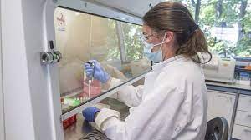
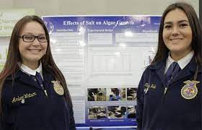
Wrap-Up

Slide 12

Chapter Spotlight:
Exeter FFA

Slide 13
...and our sets of editable icons
You can resize these icons without losing quality.
You can change the stroke and fill color; just select the icon and click on the paint bucket/pen.
In Google Slides, you can also use Flaticon’s extension, allowing you to customize and add even more icons.

Slide 14
Educational Icons
Medical Icons

Slide 15
Business Icons
Teamwork Icons

Slide 16
Help & Support Icons
Avatar Icons

Slide 17
Creative Process Icons
Performing Arts Icons

Slide 18
Nature Icons

Slide 19
SEO & Marketing Icons

