Slide 1
Module 3:
Leadership Activities & Positions

Slide 2
Module Objectives
Explore soft skills associated with Leadership Activities & Positions.
Understand the difference between modeling leadership & learning leadership.
Describe the four focus areas of leadership.
Describe reflection strategies to enhance leadership for students.

Slide 3
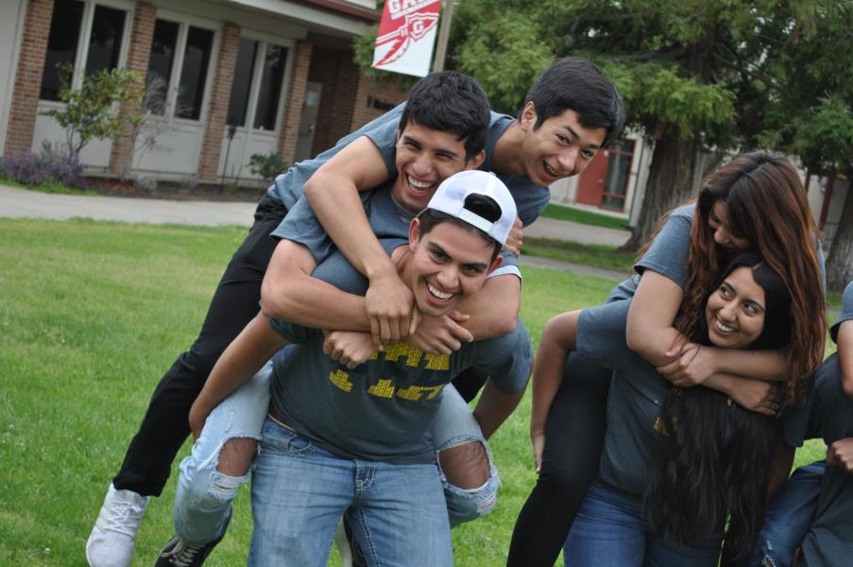
Philosophy
Participating in leadership activities and formal representative positions helps students develop critical thinking skills, exhibit emotional control, consider the impacts of their decisions, be flexible in their thinking, and persevere in solving problems.

Slide 4
Standards
Intellectual Flexibility
Task Leadership
Social Competence
Emotional Control
CRP.01 Act as a responsible and contributing citizen and employee.
CRP.04 Communicate clearly, effectively, and with reason.
CRP.05 Consider the environmental, social, and economic impacts of decisions.
CRP.08 Utilize critical thinking to make sense of problems and persevere in solving them.
CRP.09 Model integrity, ethical leadership, and effective management.

Slide 5
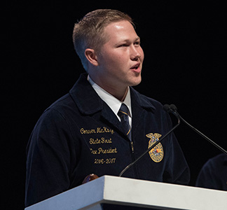
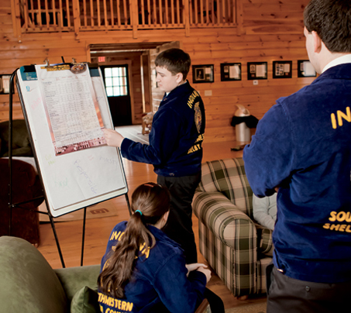
Leadership
Modeling
Learning
Vs.

Slide 6



Focus Areas
01
Identifying student’s leadership
02
Attending leadership conferences
03
Engaging in officer teams
04
Formal representative positions

Slide 7

Identifying Student’s Leadership
Leadership is not one size fits all, and everyone has a different leadership style.
Students can first figure out what their leadership style is by taking personal assessments like:
True Colors
Enneagram
Myers-Briggs

Slide 8





Attending Leadership Conferences
By attending leadership conferences students practice their social competence skills and develop intellectual flexibility, which challenges them to grow as leaders.
Change
Makers
Summit

Slide 9
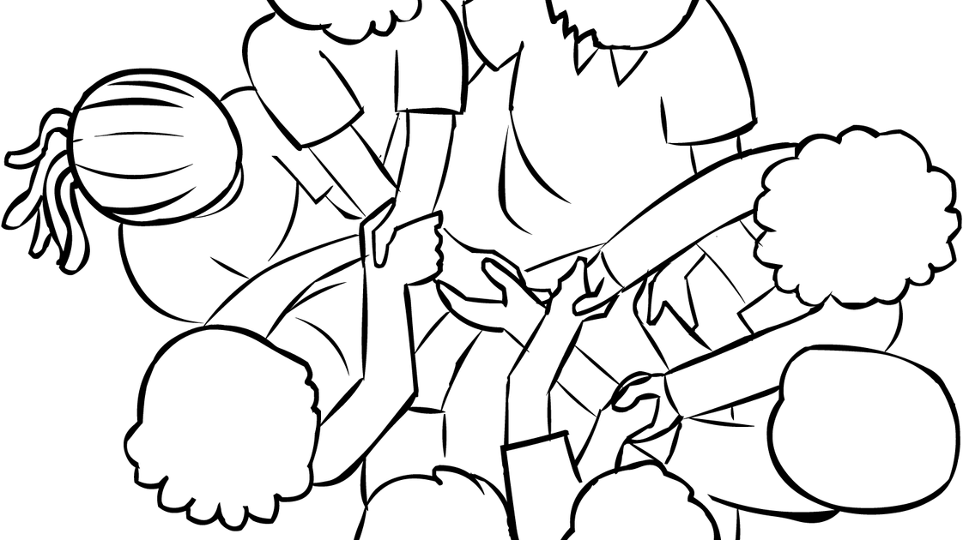

Engaging in Officer Teams
Learning leadership can be facilitated through team discussions, attending leadership workshops, planning meetings, and officer retreats.

Slide 10

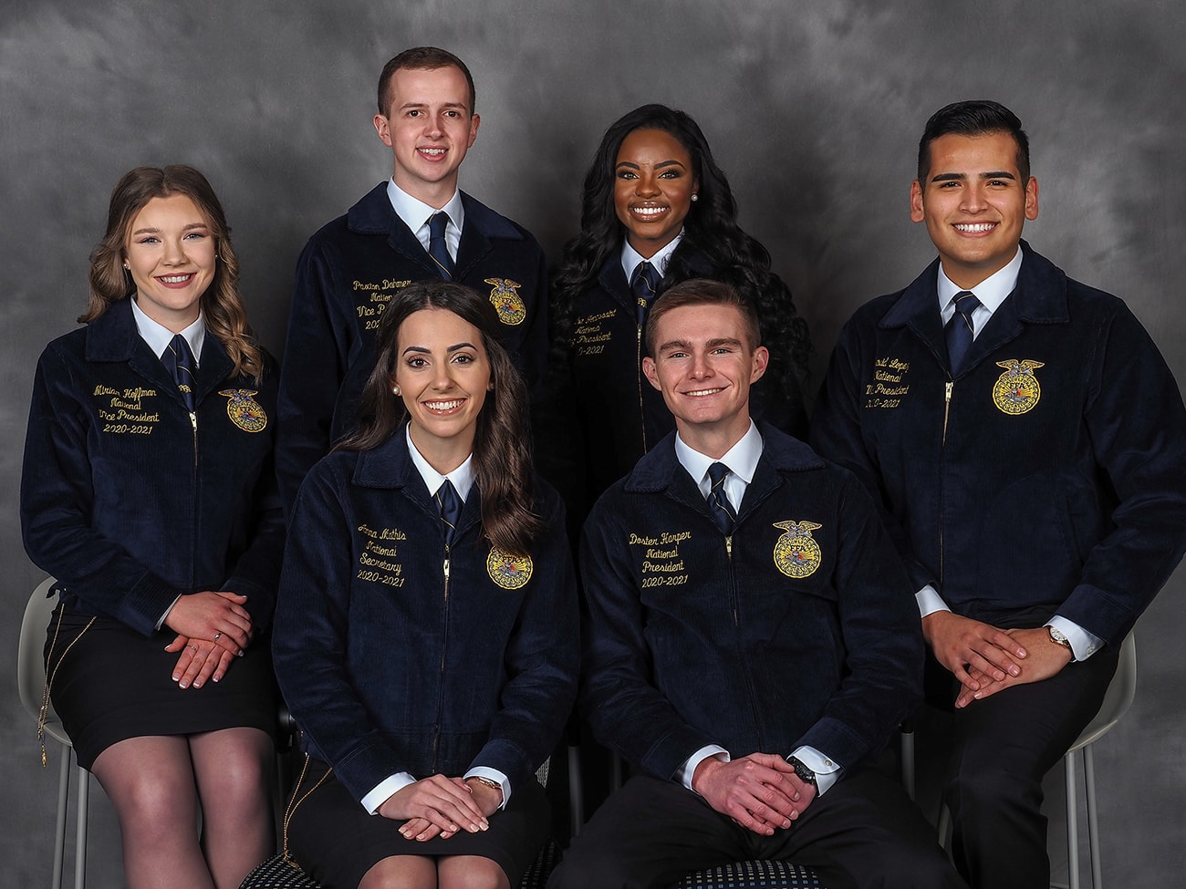
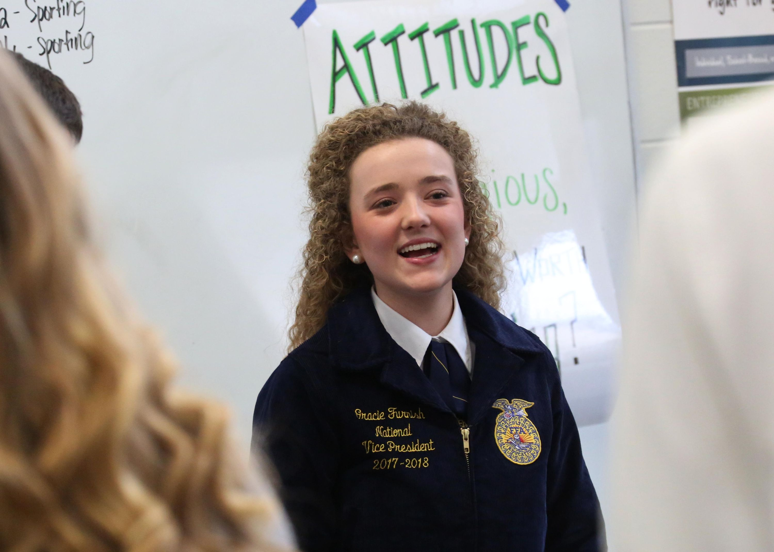
Engaging in Officer Teams
Modeling leadership is practiced when students are putting on leadership workshops, leading chapter meetings, designing team building activities, and being elected to higher offices.

Slide 11

Formal Representative Positions
Being an elected officer is not the only way for students to gain leadership experience. Other options include formal representative positions listed below, which can be accomplished both inside and outside of the classroom!
Nominating committee member/chair
Conference/chapter delegate
Committee member/chair experience
Mentorship

Slide 12

Chapter Spotlight:
Bakersfield - North FFA

