Slide 1
Module 4:
Team Participation

Slide 2
Module Objectives
Identify the soft skills associated with team participation
Describe team structure philosophy
Define the term social loafing
Describe areas to engage students in team participation.

Slide 3
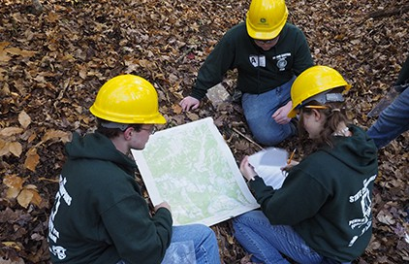
Philosophy
Working productively in teams, such as Career Development Events, gives students an opportunity to gain competence in communicating clearly, effectively, and with reason.

Slide 4
Standards
Career Ready Practices
Social Competence
CRP.04 Communicate clearly, effectively, and with reason.
CRP.12 Work productively in teams while integrating cultural and global competence.
Personal confidence and self-perceived ability in social interactions.

Slide 5
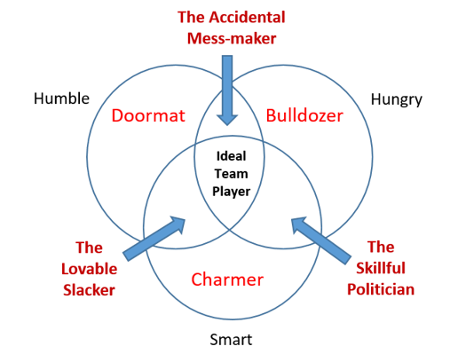
Ideal Team Player
The Ideal Team Player is Humble, Hungry, and Smart!
Each area can be developed
Students assess themselves
Encourage students to get better constantly
Patrick Lencioni

Slide 6
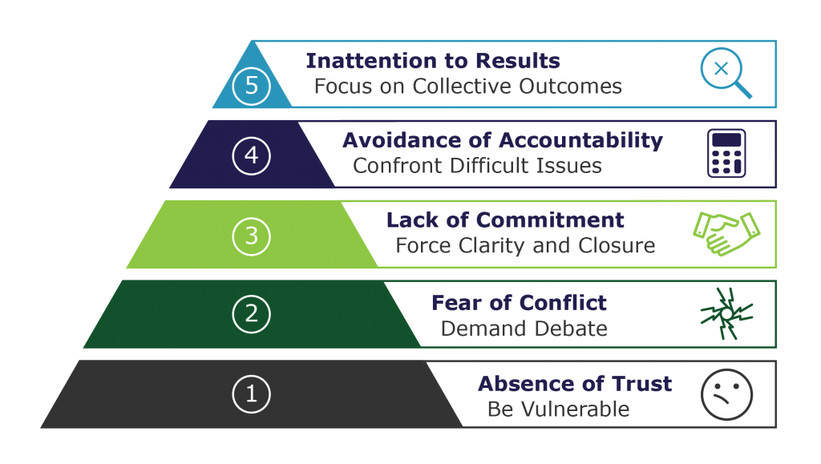
5 Dysfunctions of a Team
Patrick Lencioni
Notes:
Can’t move from one area to the next, ie: without conflict, there can be no commitment.

Slide 7
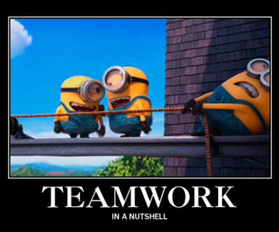
Social Loafing
Individuals tend to expend less effort when working collectively than when working individually
Make individual contributions identifiable
Evaluate individual and team contributions
Have members evaluate each others’ contribution
Create interesting/ important task
Encourage buy- in
  members allowed input into decision
  members participate in setting clear goals
  members establish clear roles

Slide 8
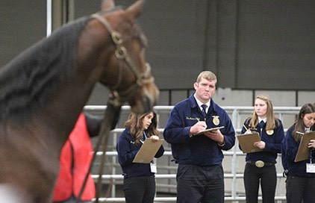
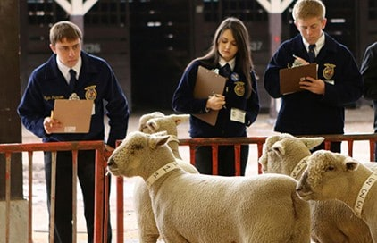
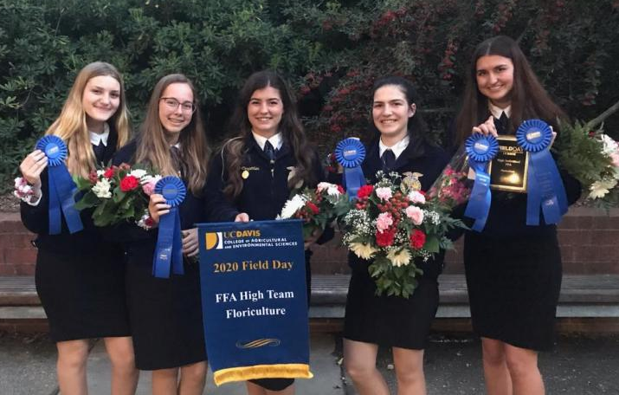
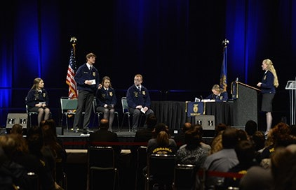
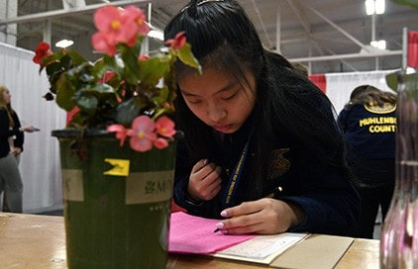
CDE Competitions

Slide 9
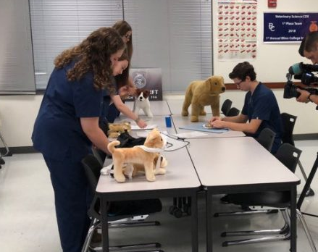
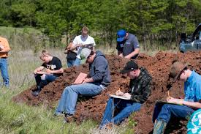
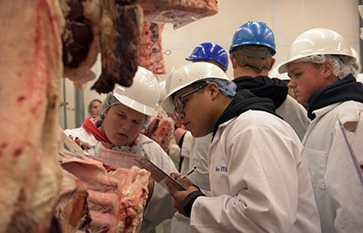
Team Practice

Slide 10
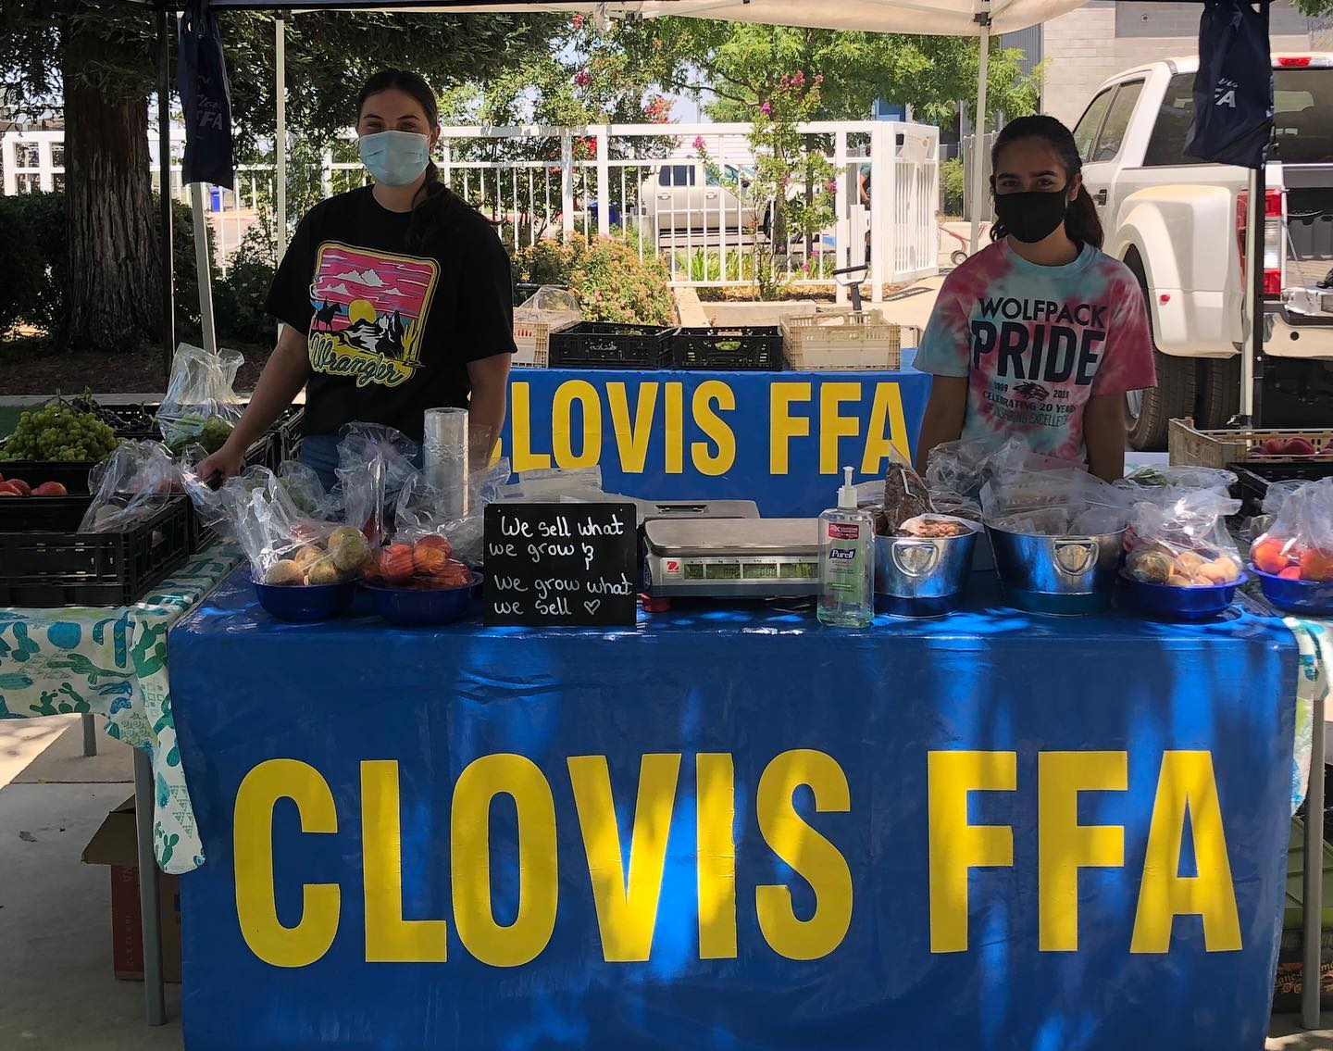
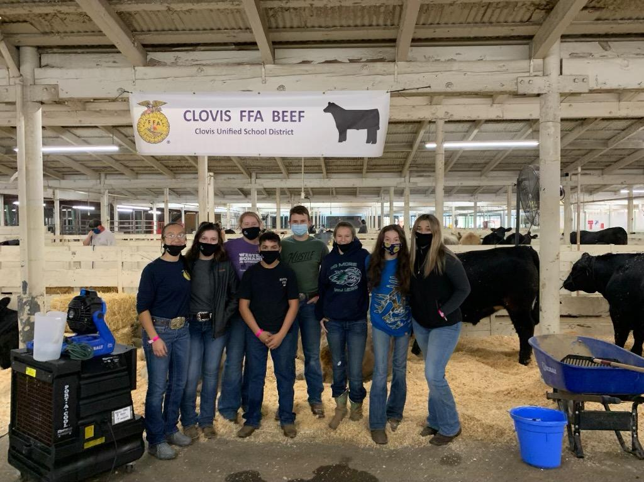
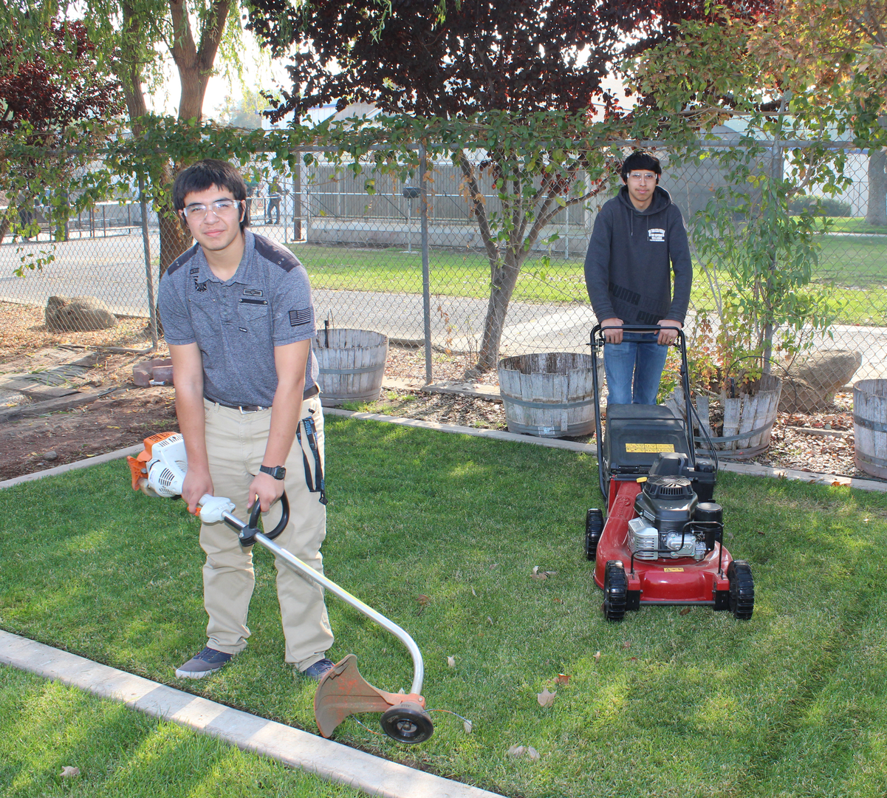
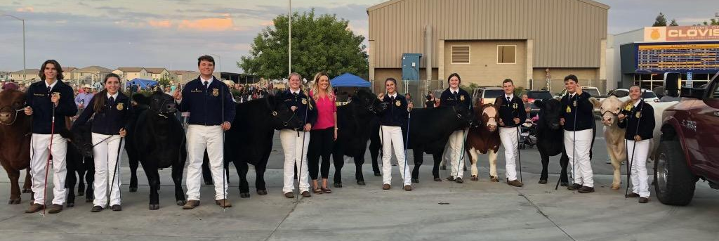
Project Teams

Slide 11
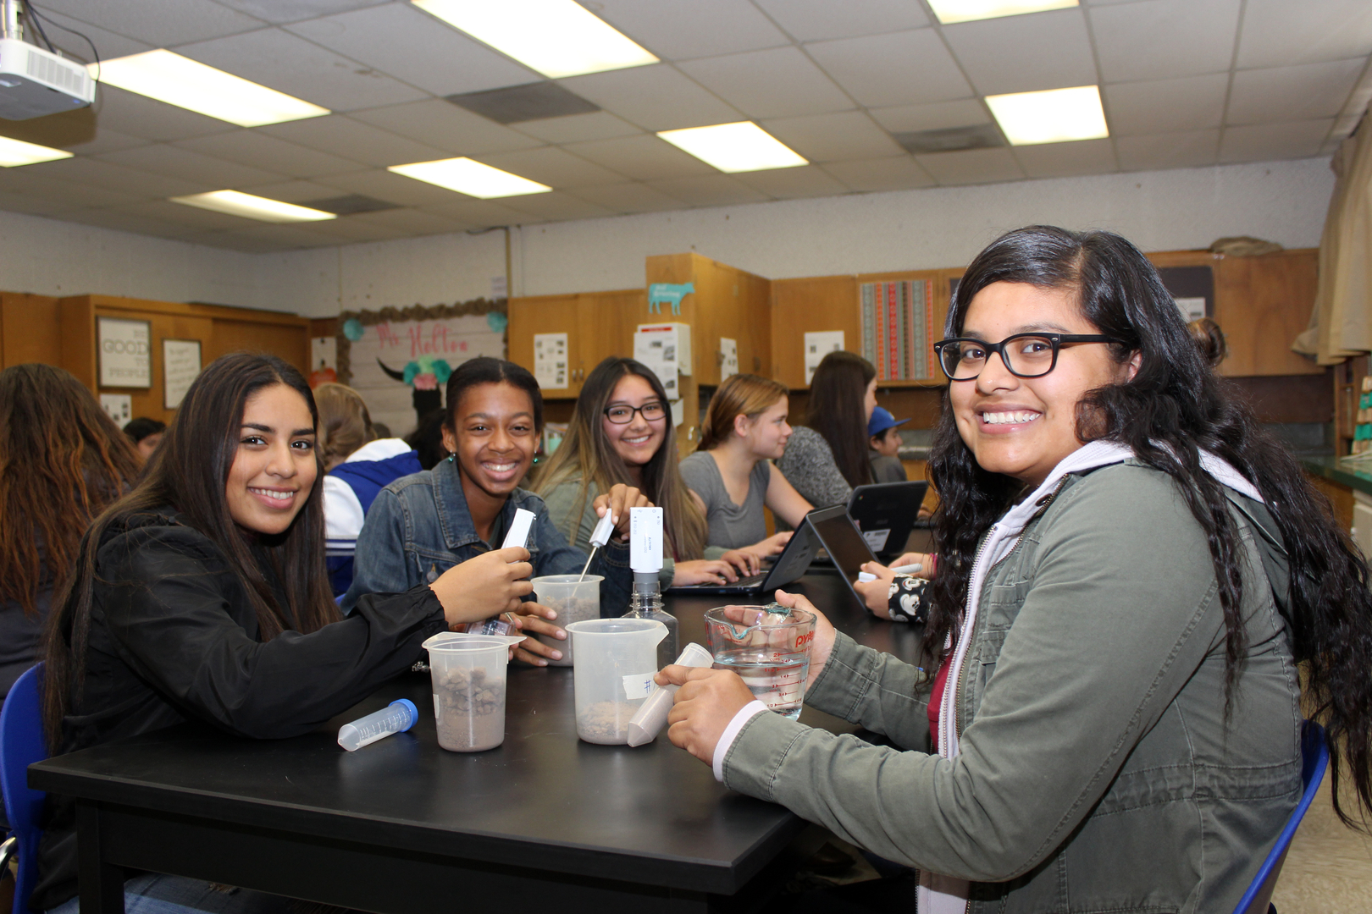
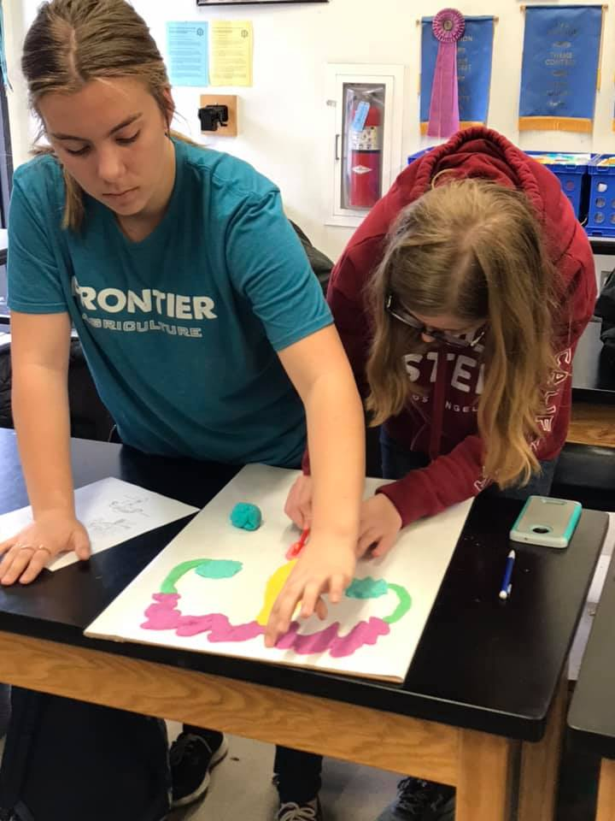
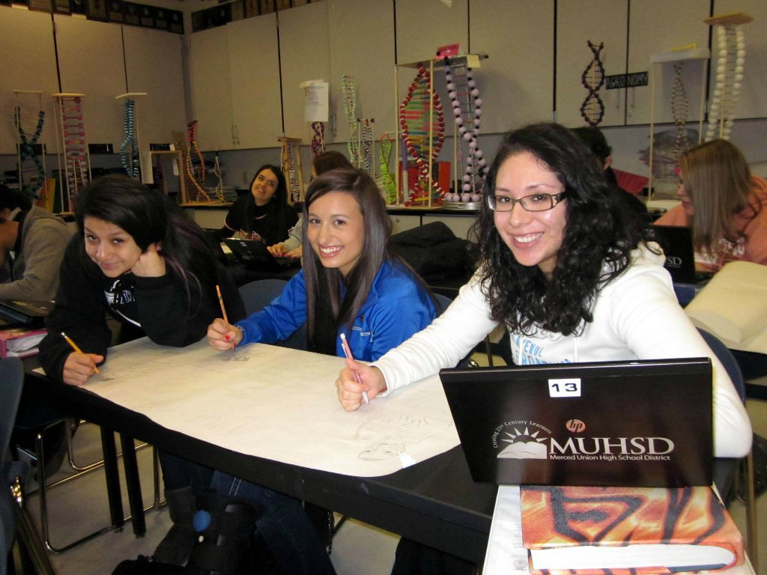
Classroom Projects

Slide 12
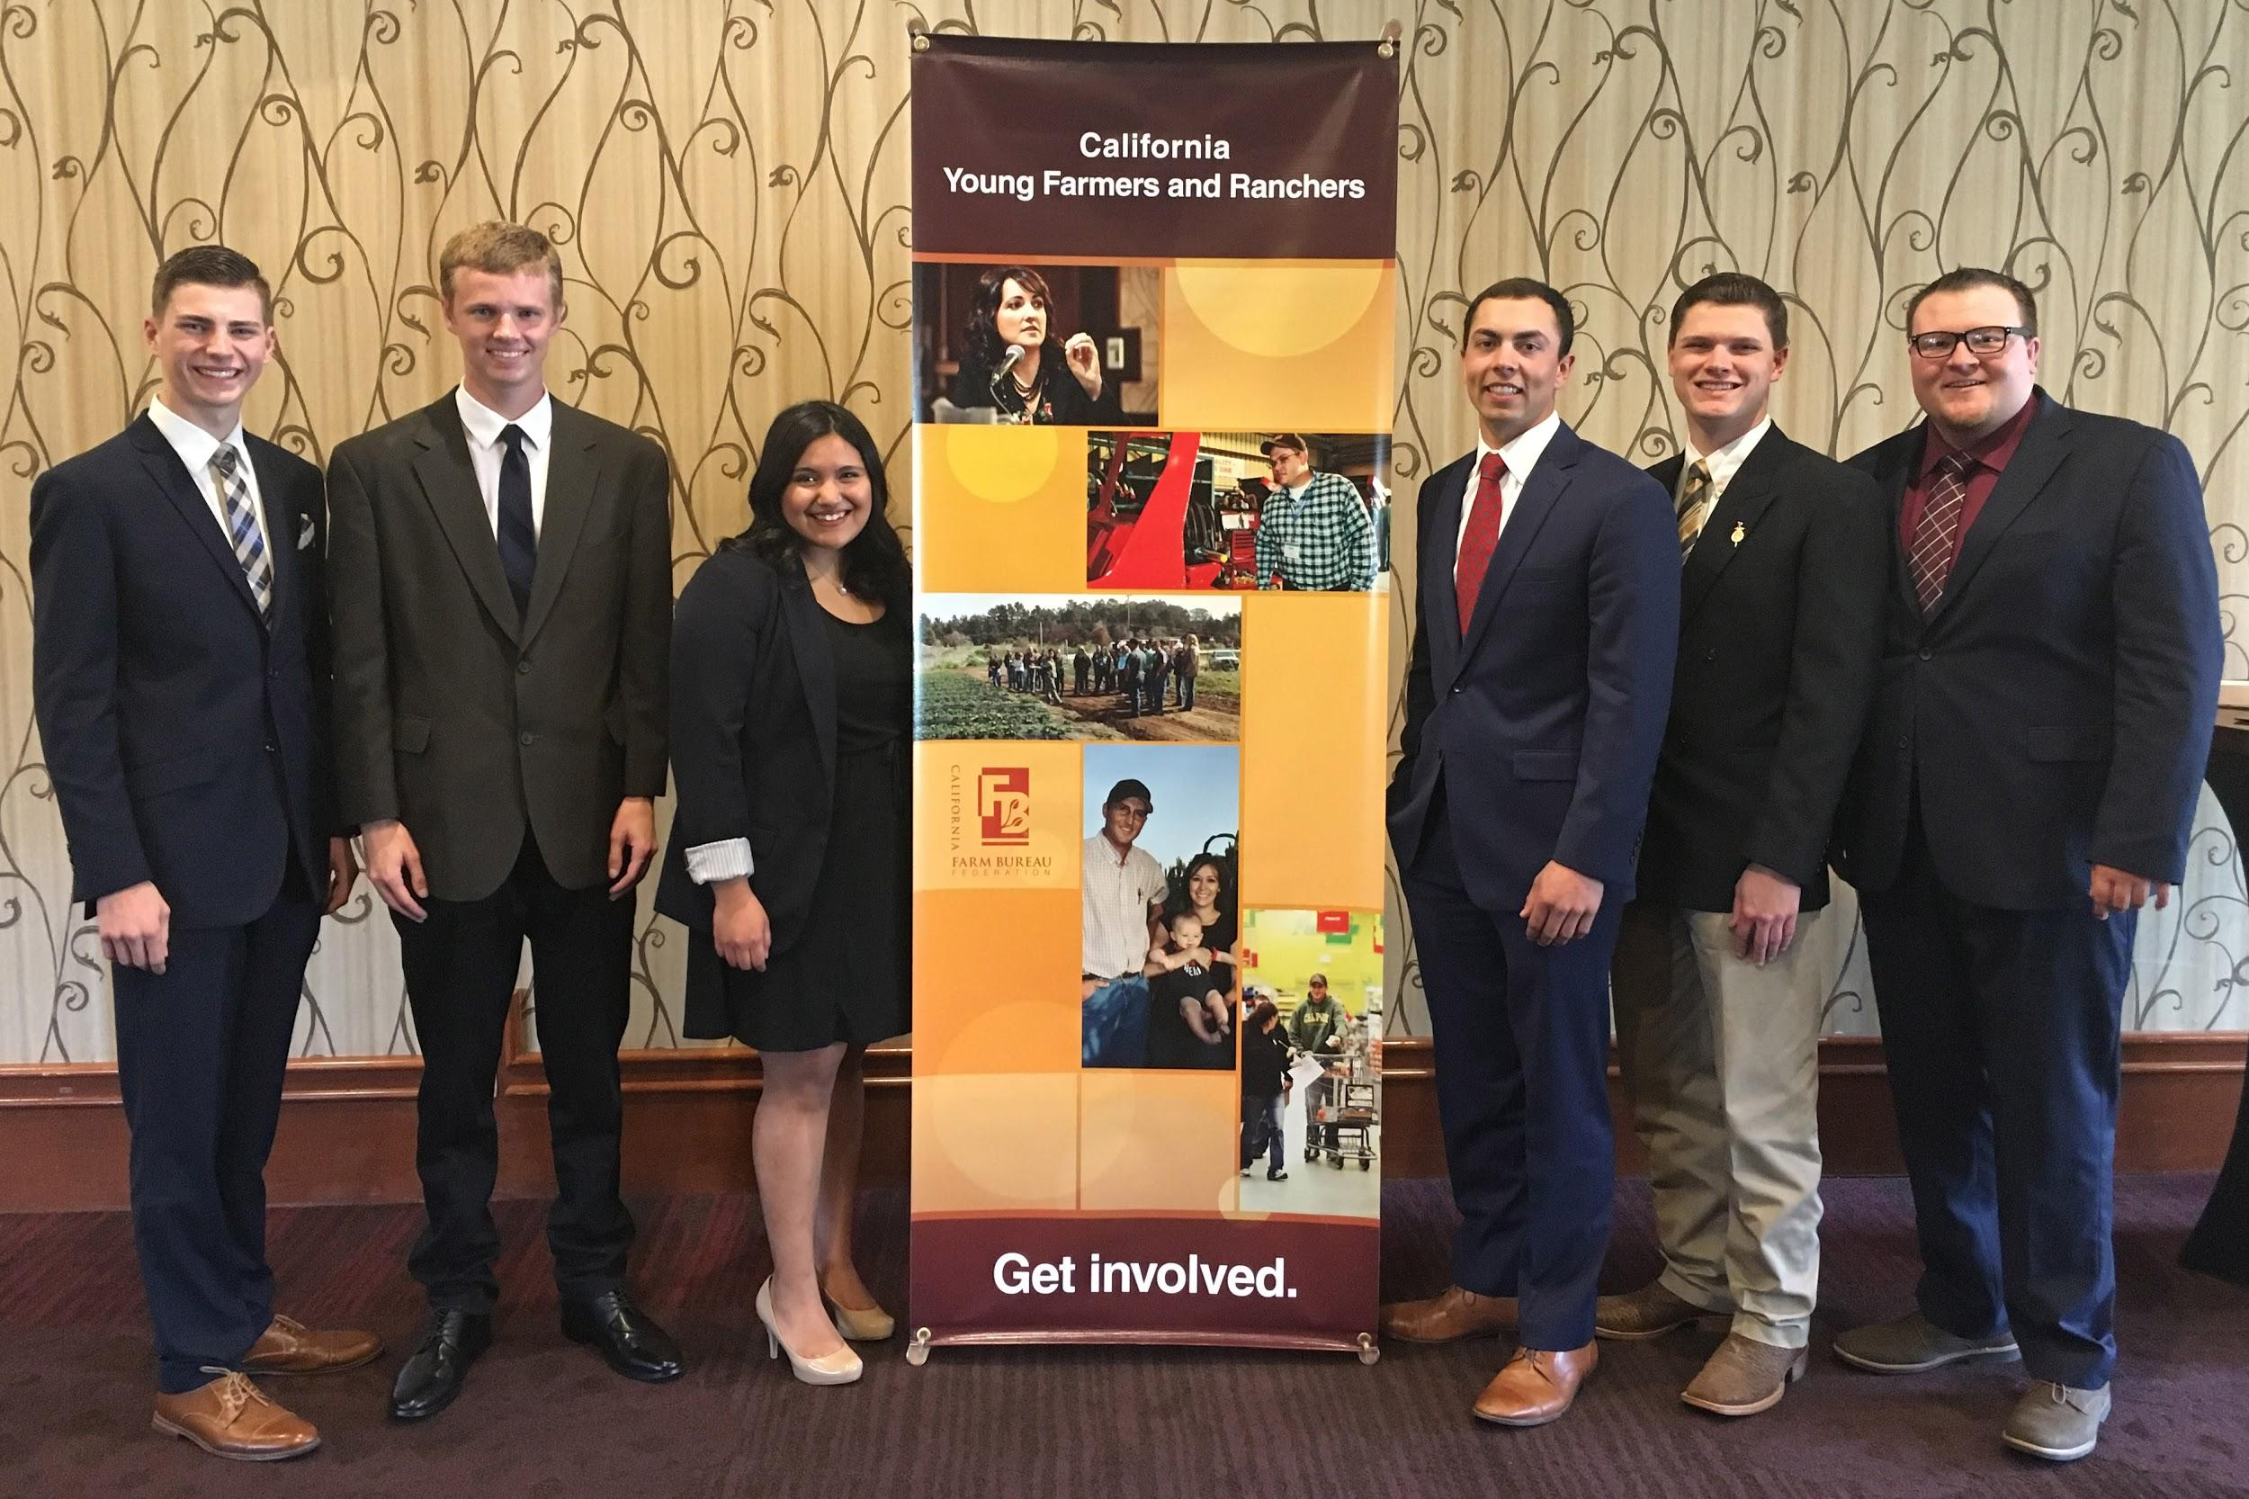
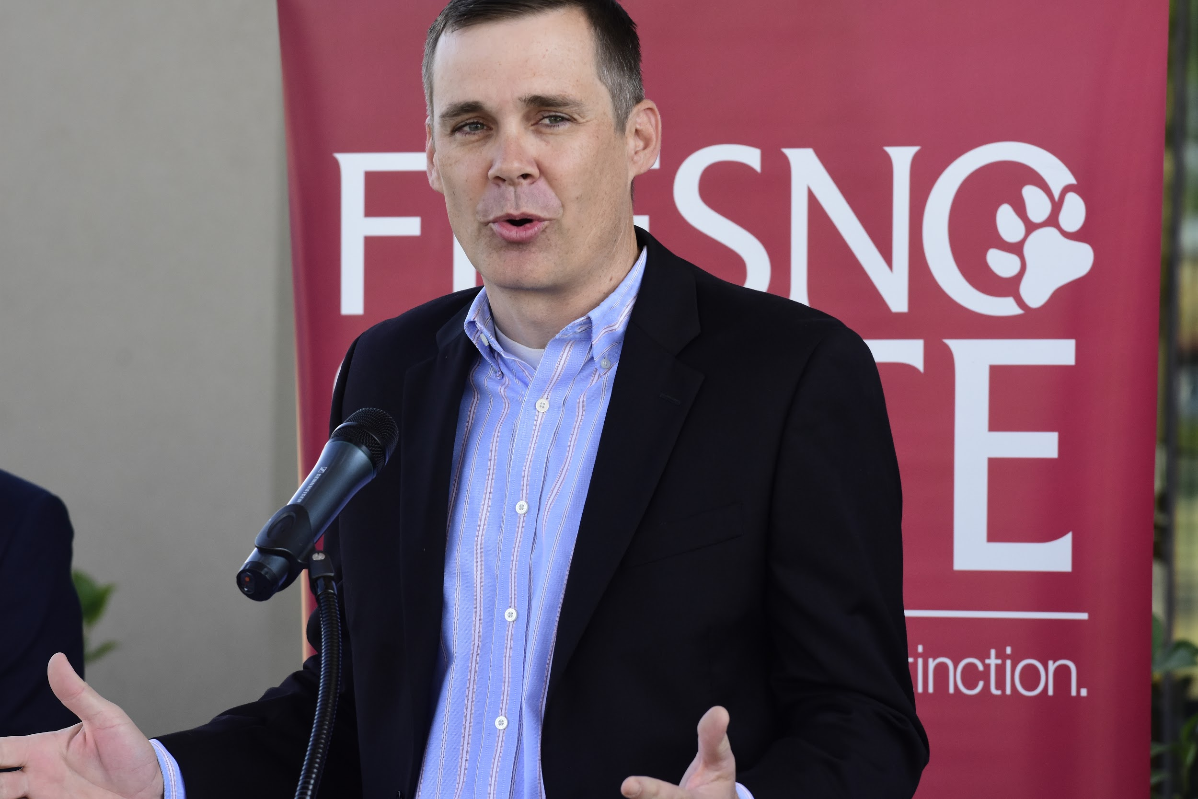
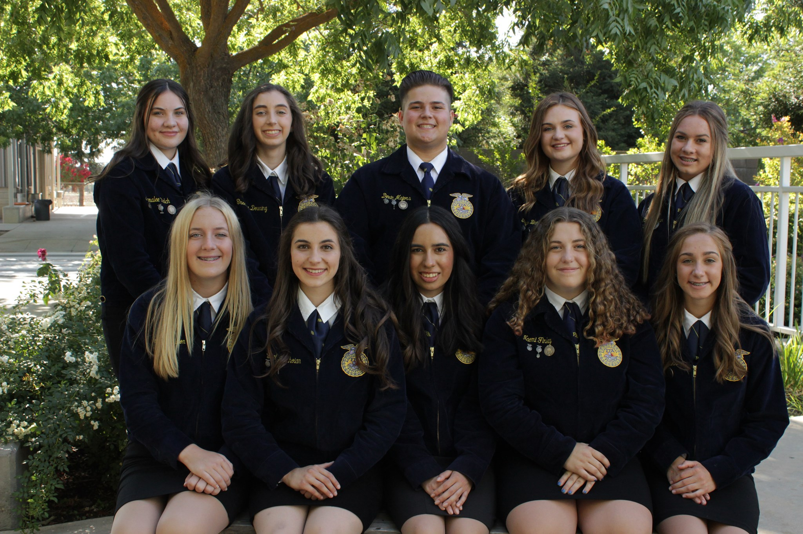
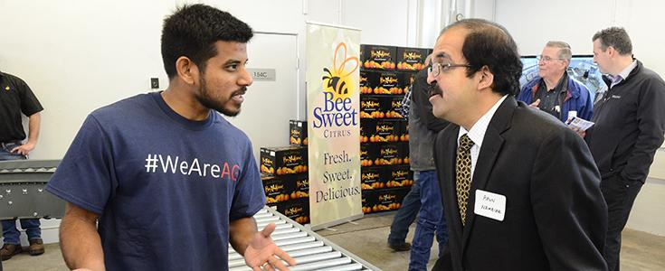
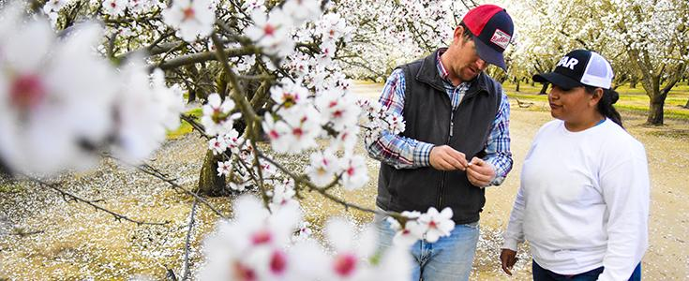
Wrap up
Notes:
Variety of pics
Team participation can happen in variety of places, all there to prep for careers
Career examples
Ask Jasmine about good flickr pics
Officer teams

Slide 13

Chapter Spotlight:
Tulare FFA

