Slide 1

Taking A Hard Look At Soft Skills
By Morgan Henson

Slide 2

What is a soft skill?
A soft skill is a personal attribute that enables someone to interact effectively
These are skills that would not typically be listed on a resume (like proficiency in a program or a degree) but that are still necessary to be an effective employee

Slide 3

Time Management
Definition: “Makes Optimum Use Of Time”
Examples: Shows up on time, does work efficiently, completes tasks within a certain time period

Slide 4
Social Competence
Definition: Personal confidence and self-perceived ability in social interactions.
Examples: Can shake someone’s hand, make eye contact, and carry on a conversation in an appropriate manner

Slide 5
Achievement Motivation
Definition: Motivated to achieve excellence and put the required effort into action to attain it.
Examples: Competitive drive, motivated by goals, goes above and beyond

Slide 6
Intellectual Flexibility
Definition: Can adapt his/her thinking and accommodate new information from changing conditions and different perspectives.
Examples: Can have a healthy discussion, can problem solve when a situation arises, can find creative solutions

Slide 7
Task Leadership
Definition: Can lead other people effectively when a task needs to be done.
Examples: Delegating tasks, motivating others, being organized and effieicent

Slide 8
Emotional Control
Definition: Maintains control when he/she is faced with potentially stressful situations.
Examples: Remains composed during criticism, can effectively speak to large groups, does not allow emotions to dictate decisions

Slide 9
Active Initiative
Definition: Likes to initiate action in new situations.
Examples: A self- starter, doesn’t need to be asked to do something, can think critically about what needs to be done

Slide 10
Self Confidence
Definition: Confidence in his/her abilities and the success of their actions.
Examples: Can complete a task without guidance, can speak to someone with self- assurance, can defend their actions

Slide 11
Game time!

Slide 12
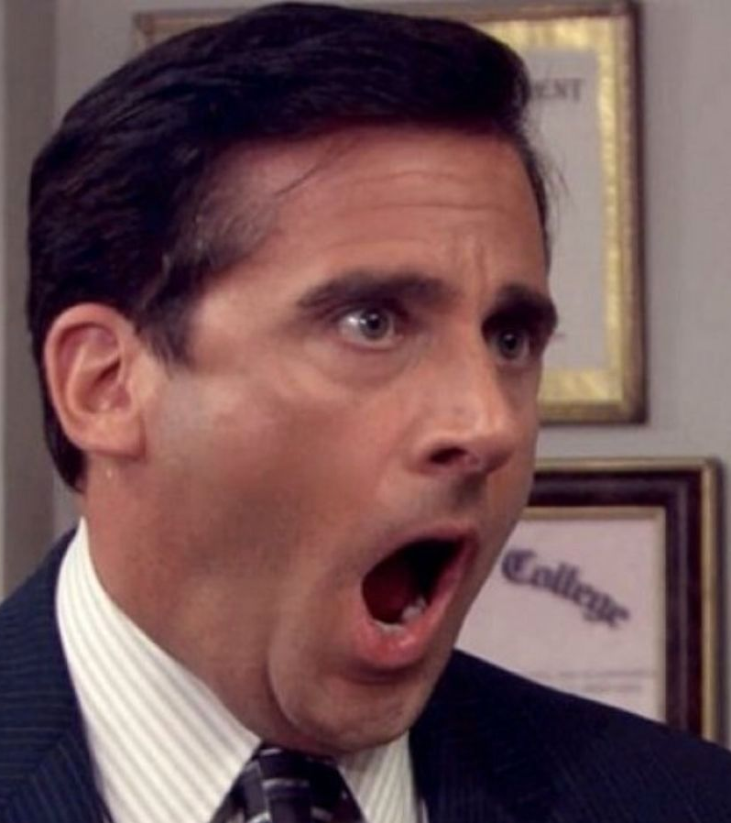
What skill is Michael NOT displaying very well in this video?
https://www.youtube.com/watch?v=CQ_eDE0OMds&list=PLKkcRMjJTBgad8i7bjqSz6dsshCLeDHAN&index=3

Slide 13
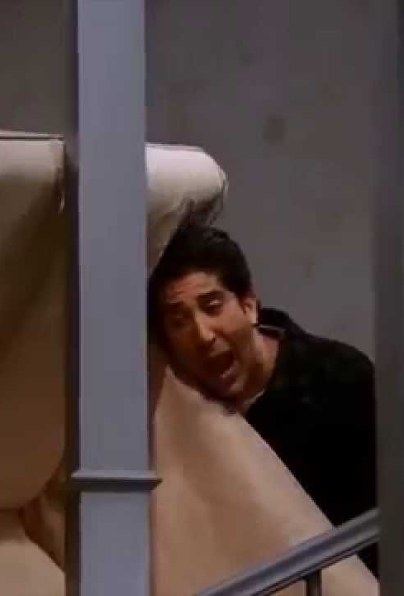
What skill does Ross use in this situation?
https://www.youtube.com/watch?v=8w3wmQAMoxQ&list=PLKkcRMjJTBgad8i7bjqSz6dsshCLeDHAN&index=6

Slide 14
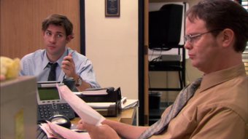
What skill of Dwight’s is Jim tracking in this video?
https://www.youtube.com/watch?v=xjyC5pv-hGc&list=PLKkcRMjJTBgad8i7bjqSz6dsshCLeDHAN

Slide 15
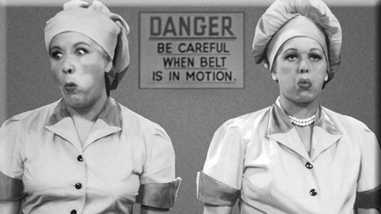
What skill(s) were Lucy and Ethel using in this situation by putting chocolates in their hats?
https://www.youtube.com/watch?v=NkQ58I53mjk&list=PLKkcRMjJTBgad8i7bjqSz6dsshCLeDHAN&index=7

Slide 16
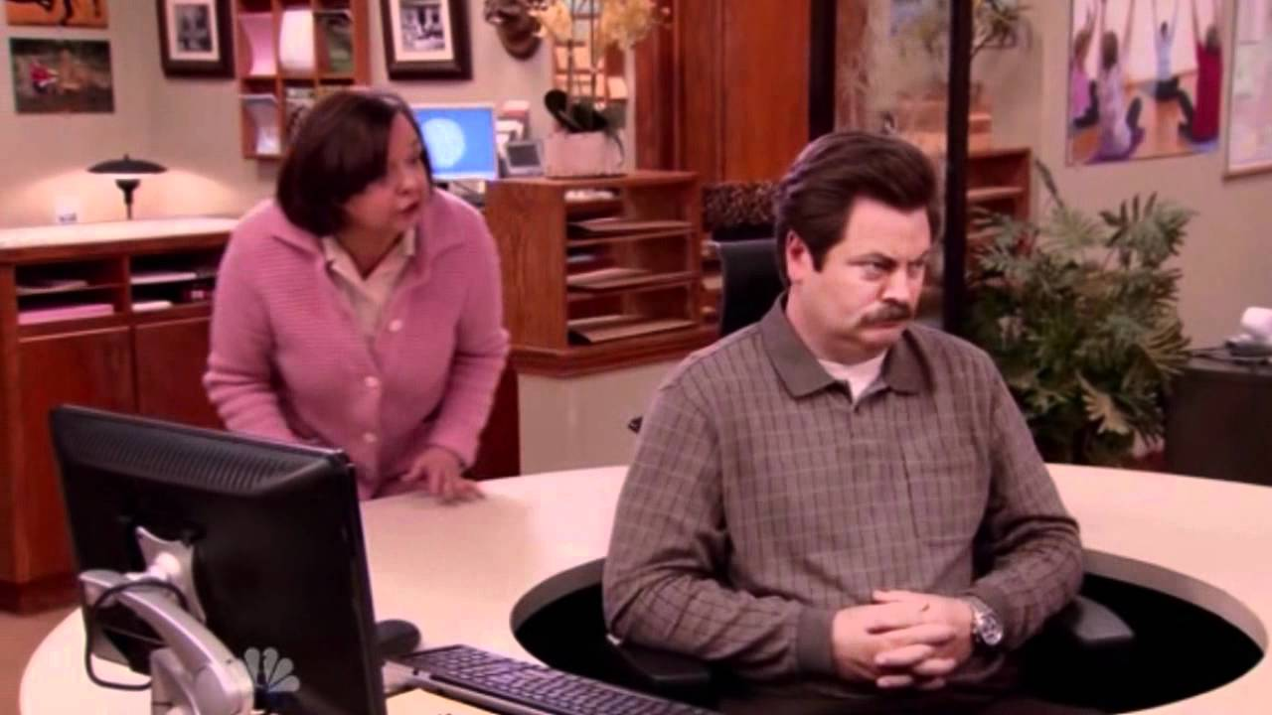
What skill in Ron NOT doing a good job of using when the woman tries to speak to him?
https://www.youtube.com/watch?v=Hyc1aMtnHJo&list=PLKkcRMjJTBgad8i7bjqSz6dsshCLeDHAN&index=2

